Slide 1
Allocations 2018-2019

Slide 2
Projected Budget Template
Will be sent in an email to the current treasurer & posted on SGA website
Must be done on computer
Fill out only yellow cells
Don’t fill in cells with formulas

Slide 3
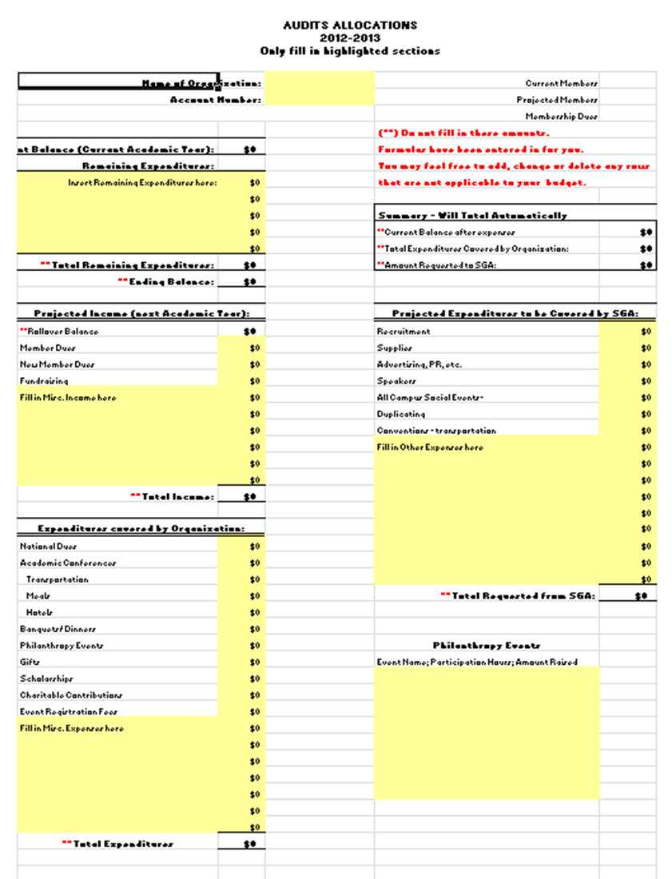
Notes:
Past Treasures of your organizations can help fill out and complete form with you.

Slide 4
Expenditures.
Current balance: Current $ in account.
Remaining Expenditures: How much you plan on spending during this final year.
Total Remaining Expenditures: Total amount of money going to be spent this year.
Ending Balance: Current Balance-Total Remaining Expenditures.

Slide 5
Projected Income.
Rollover Balance: Number from ending balance from section above.
Member dues: How much you plan on making from members dues.
New Members dues: How much you plan on making the new members pay.
Fundraising: How much money you plan on fundraising during each fundraising event.
Total Income: Rollover balance + Member dues + New Members dues + Fundraising = Total income

Slide 6
Expenditures Covered by Organization.
In this section you should include expenses YOUR organization plans on spending with money YOU raised. This is not money given by SGA, this is money that each organization will be spending on their behalf.

Slide 7
Summary:
Current balance after expenses: Purple arrow
Total Expenditures Covered by Organization: Red Arrow
Amount Requested by SGA: Green Arrow

Slide 8
Project Expenditures Covered by SGA.
This is where you and your organization will put how much money you are requesting to be funded by SGA. Each column is a different topic that SGA is available to cover. If you do not need money for each item then leave it blank.

Slide 9
Things SGA will cover
Speakers (if specifics are given)
All campus events
Travel (subject to stipulations)
Office supplies (to an extent)
Refreshments for all campus events (within reason)
Duplicating (subject to stipulations)
Advertising (subject to stipulations)

Slide 10
SGA will not cover
Hotel Expenses
Academic Conferences (in most cases)
Dinners/Banquets for the Organization
Philanthropy Contributions
Event registration fees (club sports exception)
National Organization Dues
Speakers without specific details
T-shirts, Gifts, Scholarships for members
On Campus Events for members only
“Miscellaneous”

Slide 11
Account Information on My.Westminster
Your budget status information is available in your organization’s advisor account on my.westminster.
Treasurers should meet with their organization’s advisor at least once a month in order to review the report. You may want to print out a monthly report and attach your check disbursement vouchers and deposit slips to them.
Presidents should also meet with their organization’s advisor to learn how to use and navigate through my.westminster’s budget information.
If any questions or concerns about the system Gina Vance can assist you!!!!

Slide 12
Results of Allocations
Results of an allocations will be subject to presentation before SGA Senate and will be open for discussion

