Slide 1
The world outside of medicine: careers in research, teaching and beyond.
Government Positions
Industry and Biotech
Writing
Sales
Teaching
Academia
Field Work
Graduate Training
Featuring video insights and options from alumni and other professionals in a range of fields in science.
Do I need to go to graduate school?
Should I get a PhD or a masters?
What job can I get with Bachelor’s Degree?
ResPAC
Research Professions Advisory Committee
Friday November 20th
Phillips Lecture Hall
11:40 AM

Slide 2
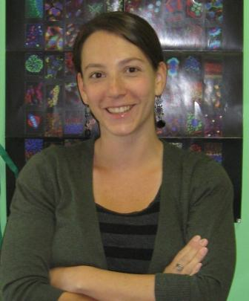
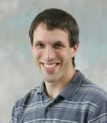
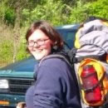
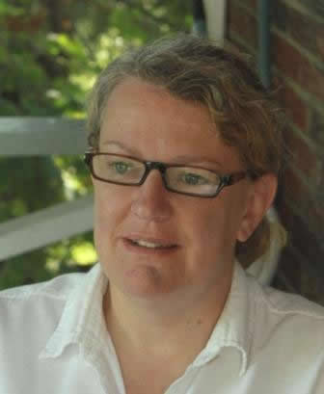
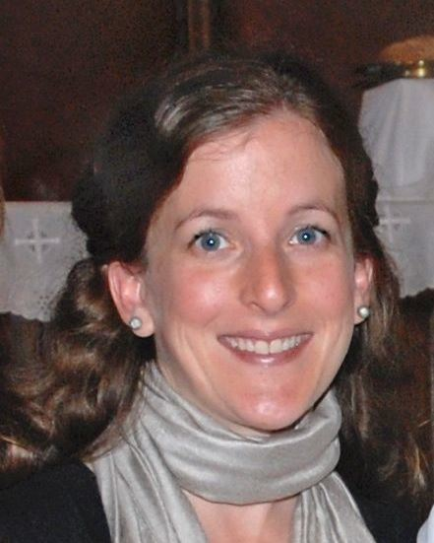
ResPAC
Research Professions Advisory Committee
Searching for Internships, Graduate Programs and Career Opportunities
CV and Personal Statement Writing Workshops
GRE Exam Informational Workshops
Mock Interviews
Website
https://www.westminster.edu/academics/respac/
my.westminster resource page
https://my.westminster.edu/ics/Campus_Life/Campus_Groups/ResPAC/Public_Page.

Slide 3
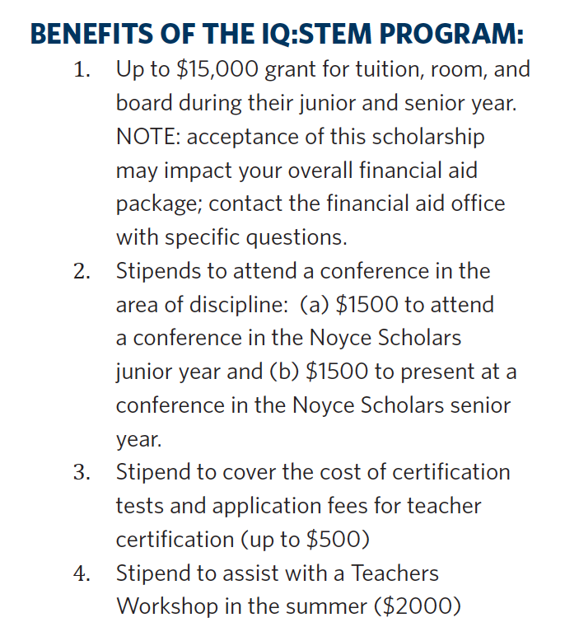
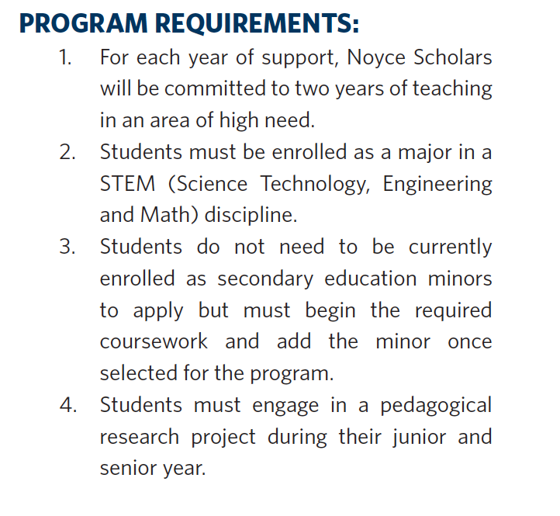
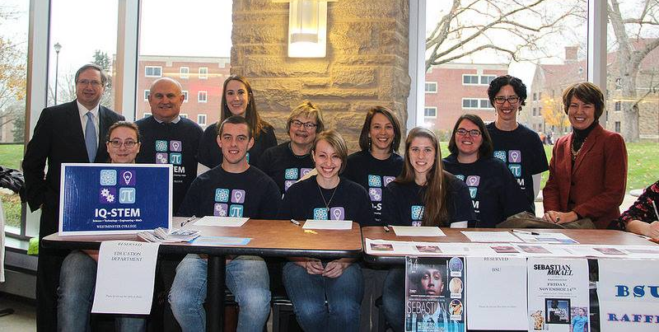
Website
https://www.westminster.edu/admissions/financial-aid/iqstem.cfm
my.westminster resource page
https://my.westminster.edu/ics/Campus_Life/Campus_Groups/IQSTEM_Noyce_Scholars/Members_Page.jnz

Slide 4
Internships and Gaining Experience
Research Experiences for Undergraduates –REU
Hospitals
Local or not so local Universities
Companies
Summer Research at Westminster
Non-profit or other organizations

Slide 5
Highlight on Teaching
Teaching
Public High School
Private High School
Community College
PUI (Primarily Undergraduate Insitution
RI Research Institution

Slide 6
Wiggio Careers in Science Website
https://westminster.wiggiosites.com/#tpl=posts_0
Chris Cassano
AP Biology, Advanced Biology 9, Physics, and Forensic Science Teacher
BS Biology (Westminster College)
Masters in Education (Westminster College)
Nicole George
High School Science Teacher at Evangel Heights Christian Academy.
BS: Chemistry; Minor in Education, Westminster College (class '13)
Part time at the Carnegie Museum of Natural History as a Museum Educator.
Brooke E. Christian
Assistant Professor of Chemistry, Appalachian State University Boone, NC
B.S. Chemistry, Appalachian State University
Ph.D. Chemistry, UNC Chapel Hill

Slide 7
Career Areas
Academia or Other Lab
Technician
Post-Doc
Government
NIH
Staff Scientist
Principle Investigator (Professor)
CDC
EPA
USDA
Industry/Biotech
Staff Scientist
Project Manager
Regulation Specialist
Clinical Trial Manager
USAMARID
Safety Officer
Animal Care Coordinator
Administrator
What can I do with a Bachelor’s Degree?
Notes:
Explain general areas then get into which you could do with only a bachelors

Slide 8
Wiggio Careers in Science Website
Doreen Hoover
Entomologist, Sterling International, Inc.
BS Biology & BS Environmental Science, Westminster College 2000.
https://www.youtube.com/watchv=ilZi29qSKBs&feature=youtu.be
Sarah Broskin
Clinical Laboratory Technician II Helomics Corporation
BS in Molecular Biology, Westminster College 2014
https://www.youtube.com/watch?v=u2VkrguvJ5U&feature=youtu.be
https://www.youtube.com/watch?v=rLL4L7BYt_4
PJ Woods
Steinman Lab, Research Specialist III, University of Pittsburgh Cancer Institute.
BS: Molecular Biology, History (Westminster College)
https://www.youtube.com/watch?v=s3Jz8B93oN8&feature=youtu.be

Slide 9
Wiggio Careers in Science Website
Veronica M Porterfield
Postdoctoral Research Associate, Neurology Dept. University of Virginia for Dr. Erin Foff 2014 to present
BS: Molecular Biology (Westminster Class of 2002)
PhD, School of Biomedical Sciences, Kent State University
https://www.youtube.com/watch?v=e3z-ibomoQU&feature=youtu.be

Slide 10
Career Areas
Other Possibilities
Aquarium
Zoos
Writing
General Scientific Publications
Patent Law
Wildlife Management
Drug Companies
Government Offices
Journal Editor
Sales
Scientific Products
Drug Companies
Large Equipment
Grant Officers
Genetic Councilor
Investor
What can I do with a Bachelor’s Degree?
Notes:
Explain general areas then get into which you could do with only a bachelors

Slide 11
Wiggio Careers in Science Website
Sarah Perdue
Science Communications Specialist University of Wisconsin Carbone Cancer Center
BS, Biochemistry, University of Wisconsin-Madison
PhD, Microbiology, Cornell University
Inga Parker La Puma
Science Communication Director, North Atlantic Fire Science Exchange
BA Geography George Mason University 1995
MS Biology Florida International University 2003 (Ecophysiology/Remote Sensing)
PhD in Ecology - Rutgers University 2012 (GIS/Remote Sensing/Landscape Ecology and Wildfire Science)
Ivorlyne (Ivy) Greene
Molecular Oncology Account Executive for Quest Diagnostics
BS: Biology (University of St. Thomas 1998)
Ph.D. (University of Texas Medical Branch 2004)
Jonathan S. Edwards
Early stage investor - Associate at Index Ventures
B.S. - Biological Sciences, UVM
PhD - Biochemistry and Biophysics, UNC Chapel Hill

Slide 12
Graduate School
Paths
Masters
PhD
Notes:
Discuss differences

Slide 13
Advanced Degree Programs exist in a wide range of fields
Biology
Biomedical engineering
Physiology and Neurobiology
Cellular and Molecular Biology
Bioinformatics
Genetic Counseling
Physiology and Developmental Biology
Pathology
Biostatistics
Microbiology
Biological Photography and Imaging
Physiology and Biophysics
Plant Biology
Anatomical Sciences
Entomology
Bioethics
Environmental Sciences
Biomaterial Science
Botany
Environmental Microbiology
Biochemistry
Genetics and Human Genetics
Nutrition
Ecology
Chemistry
Chemical Engineering
Neuroscience
Computational Biology
Animal Nutrition
Animal Science
Wildlife Science
Conservation Biology
Marine and Coastal Studies
Soil Sciences
Marine Science
Agricultural Science
Laboratory Quality Analysis and Management
Toxicology
Analytical & Pharmaceutical Chemistry
Food Science
Organic and Medicinal Chemistry
Theoretical Chemistry and Computational Modeling
Computational Chemistry and Physics
Emerging Infectious Diseases
Immunology and Molecular Pathogenesis
Virology
http://www.gradschools.com

Slide 14
Wiggio Careers in Science Website
Jasmine Grady
Master of Art's in teaching (MAT) student at Trinity International University (Deerfield, IL); while also working full-time as a live-in nanny in Highland Park IL.
BS: Molecular Biology from Westminster College 2011
Other Degrees: Master's in Bioethics from Trinity International University.
Corey N. Cunningham
3rd Year Ph.D. Student in the Cellular and Molecular Biology Ph.D. Program at the University of Michigan
Westminster College in 2013 with a Bachelor of Science in Molecular Biology
Casey Schmidt
Graduate Student at University of North Carolina Chapel Hill
B.S. Molecular Biology, Westminster College 2012
http://www.tubechop.com/watch/6979353

Slide 15
Questions?
ResPAC
Research Professions Advisory Committee

