Slide 1
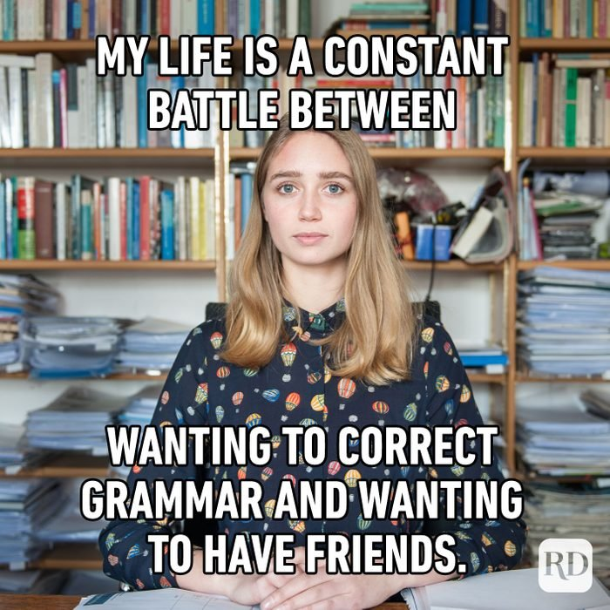
Moving Your Grammar Forward
Dr. Trisha Cowen
The Write Way Workshop Series

Slide 2
What is GrAmmar?

Slide 3
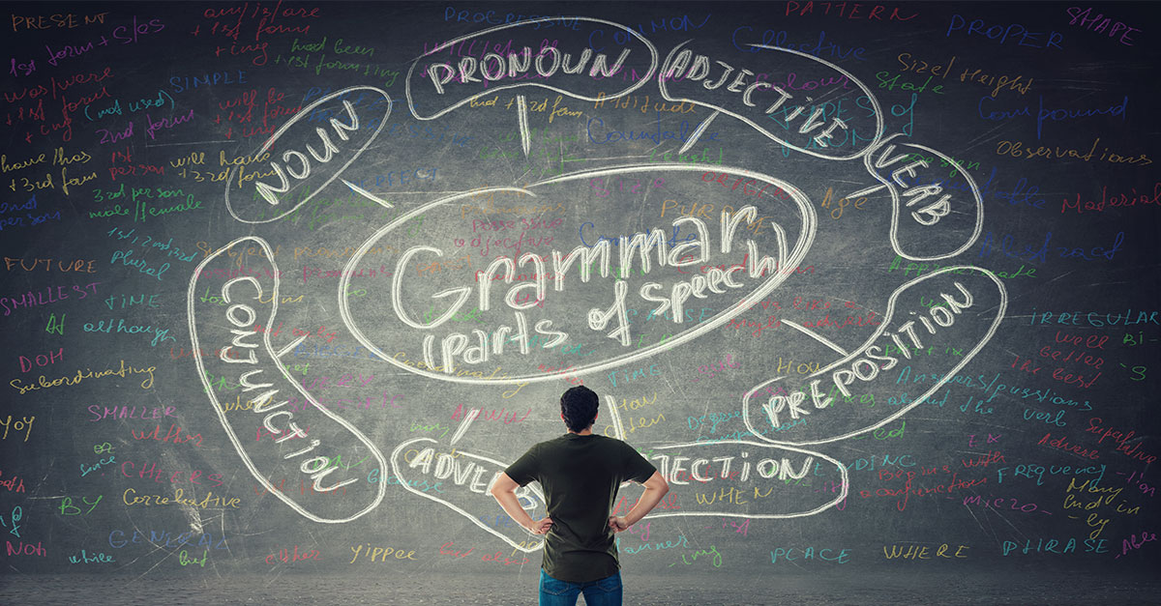
What is grammar?
The study of the way words are used to make sentences.
A body of rules imposed on a given language for speaking and writing it.
In the case of one’s native language, the rules of grammar and punctuation are often acquired not by the conscious study or instruction, but by hearing other speakers and by reading.
Much of this internalization occurs during early childhood.
Mastering a language, however, often involves more explicit instruction.

Slide 4
Why is learning grammar rules important?

Slide 5
Let’s save Grandma!

Slide 6
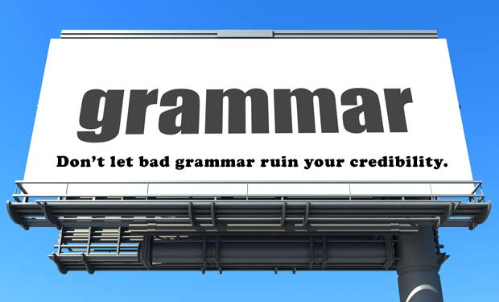

Slide 7
Key parts of Speech
Noun= a word for a person, place, or thing The rain
Pronoun= a word used in place of a noun It (to replace “rain”)
Adjective= a word to describe a noun or pronoun The sudden rain
Adjectives usually go before a noun
Verb = a word to express action or being The sudden rain fell.
Adverb = a word to describe a verb/adjective The sudden rain fell violently.
Preposition = a word before a noun or pronoun Thee sudden rain fell violently on the fields.
to form a phrase that modifies another word in the
the sentence. They locate where things are.
Ex.) toward, for, to, after, behind, between

Slide 8
Sentence Patterns
SUBJECT + VERB
Katie sings.

Slide 9
Sentence patterns
Subject + Verb + object
Katie + sings + opera.

Slide 10
Direct and Indirect Objects
A direct object is the immediate receiver of the action.
The cat bit my finger. The cat claws the furniture.
An indirect object is a “secondhand” receiver of the action.
Dad cooked dinner for us. Mom writes them long letters.

Slide 11
Common Mistakes
Passive Voice
Parallel Structure
Run-on Sentences

Slide 12
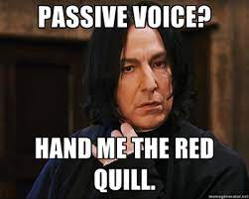
Passive Voice
The passive voice is used to show interest in the person or object that experiences an action rather than the person or object that performs the action.
In other words, the most important thing or person becomes the subject of the sentence.

Slide 13
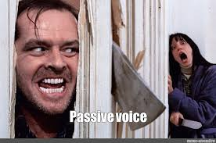
Passive Voice Vs. Active Voice
When we write in the passive voice, it becomes boring and wordy.
The line drive was caught by their rookie shortstop. (BAD)
(object + helping verb + verb + preposition + subject )
Their rookie shortstop caught the line drive. (Good)
(subject + verb + object )

Slide 14
Sign Posts that we have the Passive Voice
Is, was, were, to be, being, etc.

Slide 15
Passive Voice
Cinderella is washing her clothes. (Bad)
Cinderella washes her clothes. (Good)
Popular culture is shaped by market forces as much as anything else. (Bad)
Market forces shape popular culture as much as anything else. (Good)
A statement of religious affiliation used to be required by employers. (Bad)
Employers used to require a statement of religious affiliation. (Good)
The Christmas decorations were not taken down at our house until January. (Bad)
We did not take down our Christmas decorations until January. (Good)

Slide 16
Parallel Structure
Parallel structure (also called parallelism) is the repetition of a chosen grammatical form within a sentence.
By making each compared item or idea in your sentence follow the same grammatical pattern, you create a parallel structure.

Slide 17
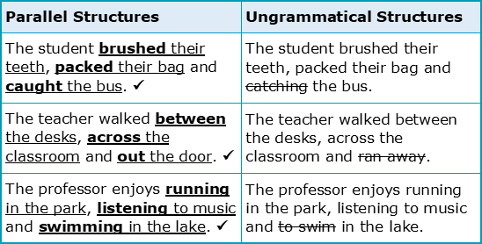
Parallel Structure
,
.

Slide 18
Activity

Slide 19
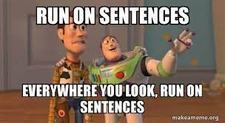
Run-On Sentences
Run-on sentences are known as fused sentences.
They occur when two complete sentences are squashed together without using a coordinating conjunction or proper punctuation, such as a period or a semicolon.
Run-on sentences can be short or long.
A long sentence isn't necessarily a run-on sentence.

Slide 20
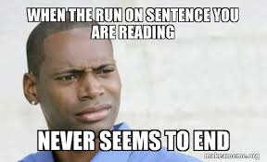
Types of Run-On Sentences
Run-on sentences come in many different varieties.
A comma splice happens when a comma, rather than a semicolon, has been used to join independent clauses.
A fused sentence mashes two main clauses together with no punctuation at all.

Slide 21
Run - On Sentences
They weren't dangerous criminals they were detectives in disguise.
They weren't dangerous criminals; they were detectives in disguise. (Good)
I didn't know which job I wanted I was too confused to decide.
I didn't know which job I wanted, and I was too confused to decide. (Good)

Slide 22
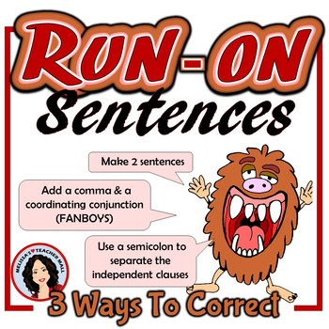

Slide 23
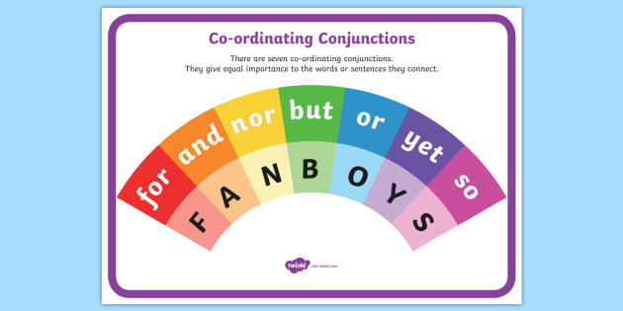
CoorDinating Conjunction

Slide 24
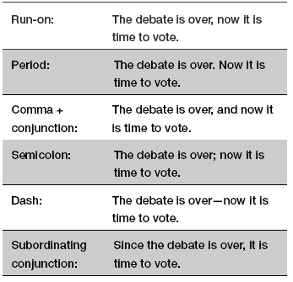

Slide 25
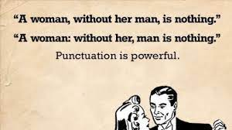
Activity

