Slide 1
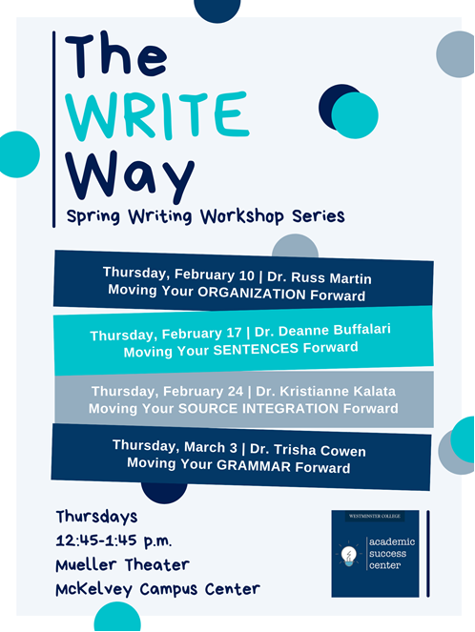
Moving Your Organization Forward, Or: Some Seemingly Random Thoughts on Organizing Your Writing and Writing Process
Dr. Russell Martin
History

Slide 2
A timeline for your work (one scenario)
Paper Distributed
Due Date
W H E N Y O U ‘ R E W O R K I N G ON T H E P A P E R
Draft 1
(yes, not an attempt at humor)
Draft 2
(ditto)
Draft 3
(ditto, ditto)
Beginning of the Semester: READ the Syllabus
End of the Semester: SLEEP for days

Slide 3
Paper Distributed
Due Date
Stages of Drafting
W H E N Y O U ‘ R E W O R K I N G ON T H E P A P E R
Draft 1:
Warm Up—write and delete (10 – 15 minutes)
Transfer research notes to text; don’t worry about structure
Write freely, and let the writing process present ideas
Go back and do more research, check notes, and THINK about ideas that presented themselves in the writing process
Draft 1
Draft 2
Draft 3

Slide 4
Random Thoughts: Taking Notes
About this paragraph:
Too many facts to record them all.
More red than black!
Select ONE fact ONLY
Learn how to select
In selecting, you remember it all (not just the selected fact).
Which fact is most important? IT DEPENDS!!! But force yourself to write down only ONE.
Let’s try it: PICK ONE.
Dante Alighieri (1265 – 1321) came from an old Florentine noble family that had fallen on hard times. Although he had held high political office in republican Florence, factional conflict led to his exile from the city in 1302. Until the end of his life, Dante hoped to return to his beloved Florence, but his wish remained unfulfilled.
(Jackson J. Spielvogel, Western Civilization, 10th edition, p. 322).

Slide 5
Exercise: taking notes
Looking at the paragraph to the left, what single note would you take if your paper topic was:
Political strife in Renaissance Florence
Dante’s family background
Dante’s feelings about Florence
Dante Alighieri (1265 – 1321) came from an old Florentine noble family that had fallen on hard times. Although he had held high political office in republican Florence, factional conflict led to his exile from the city in 1302. Until the end of his life, Dante hoped to return to his beloved Florence, but his wish remained unfulfilled.
(Jackson J. Spielvogel, Western Civilization, 10th edition, p. 322).

Slide 6
Paper Distributed
Due Date
Stages of Drafting
W H E N Y O U ‘ R E W O R K I N G ON T H E P A P E R
Draft 2:
Warm Up—write and delete (10 – 15 minutes)
Focus on the argument
Arguments: Thesis
Arguments: Topic Sentences
Arguments: Good, developed paragraphs
Arguments: VERBS (and the evil of the passive voice)
Arguments: Sequence of ideas
Draft 1
Draft 2
Draft 3

Slide 7
Random Thoughts: Structure, Style, and Arguments
Have an argument: THESIS
Make your argument: FACTS supporting the thesis
But also this:
Structure:
Consider your topic sentences (read them in isolation)
Consider your paragraphs as key points you make (linked to facts)
Consider sections of the body
The painfully misunderstood Conclusion
Style:
The evil passive voice
Pacing
All the other things about grammar that other sessions will discuss
Words:
Verbs, again verbs
But also consider the lesson of 10th-grade English—Why you really studied poetry!

Slide 8
Paper Distributed
Due Date
Stages of Drafting
W H E N Y O U ‘ R E W O R K I N G ON T H E P A P E R
Draft 3:
Warm Up—write and delete (10 – 15 minutes)
The “Dilemma of the Perfect-Looking Printout”
Fixing the argument: the beauty of cutting and pasting
LINE EDITING
Draft 1
Draft 2
Draft 3

Slide 9
Random Thoughts: Line Editing
You’re never done editing; you’ve just reached the deadline
Quibble with words: “Lomonosov asks, “Does not love reign here?” His answer comes in the form of a long and learnèd, though somewhat random rambling disconnected disjointed jumbled list of Russia’s Edenic qualities, drawing on classical tales of both nature and love.”
Macro and micro editing: Moving parts and quibbling with words
YOU’RE NEVER FINISHED, BUT DON’T STOP UNTIL THE DEADLINE SAYS YOU MUST

Slide 10
Exercise: Line Editing
You’re never done editing; you’ve just reached the deadline
How might you edit this passage to make it better?
“That religion influenced the daily lives of lay Muscovites, including during the reign of Ivan IV, is hardly a new conclusion, but recent publications have provided considerable additional evidence of that influence.”
Charles J. Halperin, Ivan IV and Muscovy (Bloomington: Slavica, 2020), 145.

Slide 11
Exercise: Line Editing
You’re never done editing; you’ve just reached the deadline
How might you edit this passage to make it better?
“The claim that religion influenced the daily lives of lay Muscovites, including during the reign of Ivan IV, is hardly a new conclusion, but recent publications have provided considerable additional evidence of it that influence.”
Charles J. Halperin, Ivan IV and Muscovy (Bloomington: Slavica, 2020), 145.

Slide 12
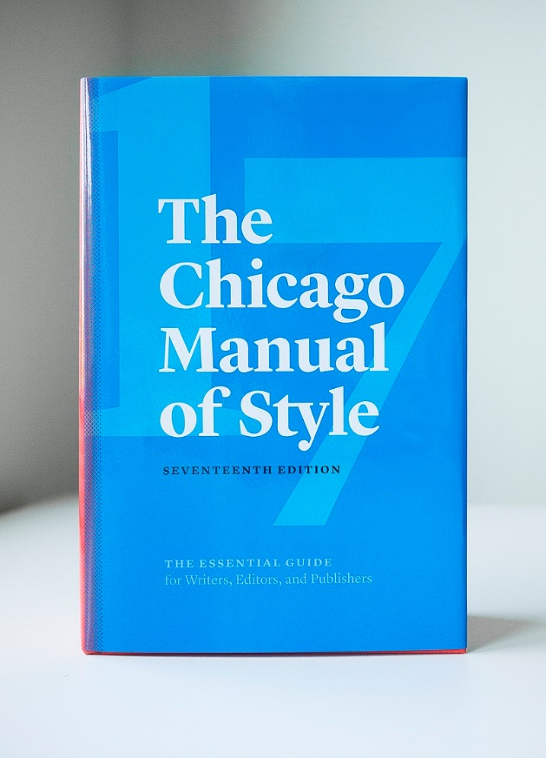
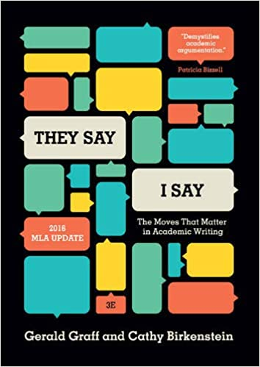
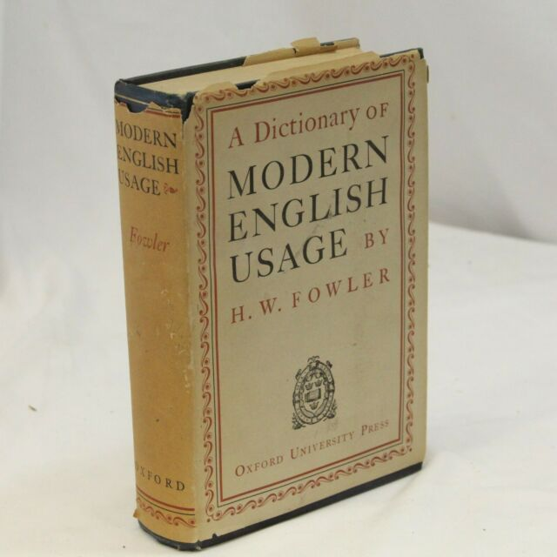
Some suggested books to own:
Photo: Amazon
The Chicago Manual of Style (currently in its 17th edition). The Holy Bible for all things academic.
Graff, Gerald, and Cathy Birkenstein, They Say, I Say: The Moves That Matter in Academic Writing, 3rd ed., Norton, 2006.
Controversially: Fowler’s Modern English Usage (preferably only the first edition).
Less controversially: Benjamin Dreyer, Dreyer’s English: An Utterly Correct Guide to Clarity and Style, Random House, 2019.
Photo: Wikipedia
Photo: Amazon
Photo: ebay

Slide 13
Moving Your Organization Forward, Or: Some Seemingly Random Thoughts on Organizing Your Writing and Writing Process
Dr. Russell Martin
History

