Slide 1
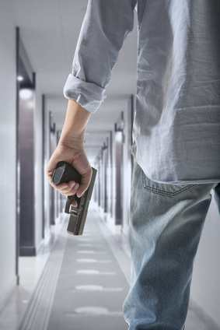
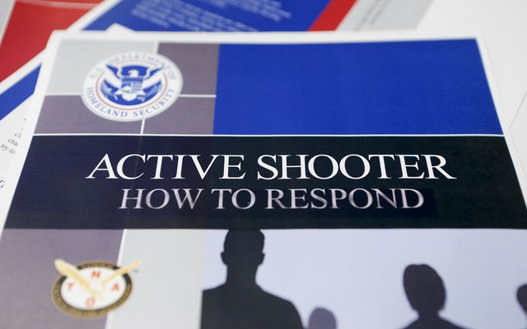
Active Shooter Awareness
Bureau of Workers’ Compensation
PA Training for Health & Safety (PATHS)
Based on FEMA’s IS-907:
Active Shooter Program
Notes:
“The number of incidents in which a shooter opens fire on a crowd of people more than doubled over the past seven years compared with the previous seven, the FBI found in a study made public Wednesday.
“The Federal Bureau of Investigation analyzed 160 "active shooter" incidents from 2000 through 2013 to look for common elements that might guide law enforcement officers in preventing the shootings or responding more effectively.
The study found an average of six incidents per year from 2000 through 2006. The number rose to 16 incidents annually in the past seven years.”
www.usatoday.com/.../09/24/active-shooter-incidents-rising.../
Photo: rjwestmore.com
And patriotoutdoornews.com

Slide 2
Topics
Profile of potential Active Shooter
Preventing and preparing for active shooter incidents
Facility survey for protective actions
Potential violence indicators
Emergency Response Planning and Training
Your actions when confronted by an Active Shooter
Law Enforcement actions
Post-Event Actions
Notes:
During this program we will address:
Profile of potential Active Shooter
Preventing and preparing for active shooter incidents
Facility survey for protective actions
Potential violence indicators
Emergency Response Planning and Training
Your actions when confronted by an Active Shooter
Law Enforcement actions
Post-Event Actions

Slide 3
Course Objectives
To provide basic information on FEMA’s Active Shooter: IS-907 program
Case Histories
Preparedness and Prevention
Emergency Action Plans
Responsibilities of Management and Staff
Your response during an incident
Law enforcement’s response actions
Managing the consequences of an active shooter incident
Notes:
The objectives for this training are as follows:
To provide basic information on FEMA’s Active Shooter: IS-907 program
Case Histories
Preparedness and Prevention
Emergency Action Plans
Responsibilities of Management and Staff
Your response during an incident
Law enforcement’s response actions
Managing the consequences of an active shooter incident

Slide 4
Active Shooter Defined*
“An Active Shooter is an individual actively engaged in killing or attempting to kill people in a confined and populated area; in most cases, active shooters use firearm(s) and there is no pattern or method to their selection of victims.”
This excludes domestic violence, drug or gang-related shooters
Notes:
*Taken from “Active Shooter, How to Respond,” U.S. Department of Homeland Security, 2008
Photo: groundreport.com

Slide 5
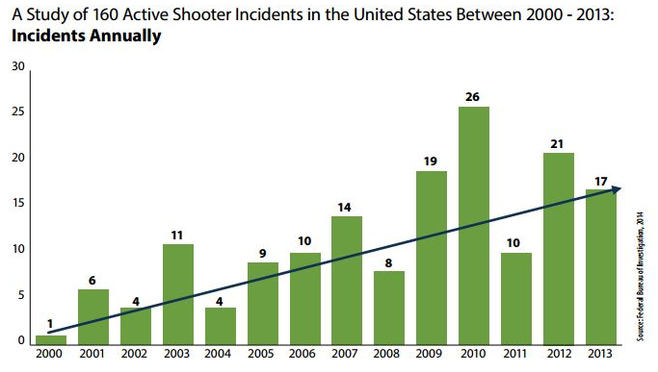
Case History
Incidents (2000-2013) FBI identified 160 Active Shooter events.
Notes:
Source: Federal Bureau of Investigation
Photo: westernjournalism.com

Slide 6
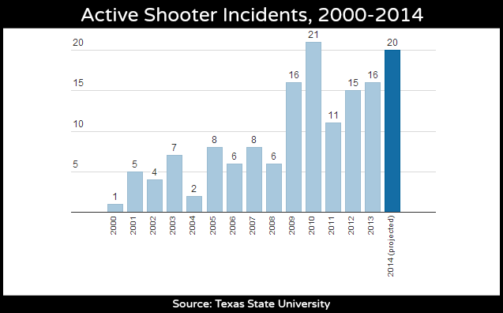
Case Histories
2014: 20 projected
2015: 46 events
Notes:
2000-2014 incidents from Texas State University, as reported in Regroup at http://www.regroup.com/welcome/active-shooter-events-on-track-to-rise-again-in-2014

Slide 7
Case Histories
The FBI identified 160 active shooter incidents between 2000 and 2013. Among the study results:
An average of 11.4 incidents occurred annually with an increasing trend from 2000 to 2013.
An average of 6.4 occurred in the first 7 years studied and an average of 16.4 occurred in the last 7 years.
Incidents occurred in 40 of 50 states and the District of Columbia.
70% of the incidents occurred in a commerce (73, 46%), or education (39, 24%) environment.
Notes:
“Active Shooter Study: Quick Reference Guide,” FBI, 2014

Slide 8
Case Histories
60% of the incidents ended before police arrived.
In 63 incidents where the duration of incident could be ascertained, 44 (69%) ended in 5 minutes or less, with 23 ending in 2 minutes or less.
64 (40%) incidents fell within the parameters of the federal definition of “mass killing” (3 or more killed).
Notes:
“Active Shooter Study: Quick Reference Guide,” FBI, 2014

Slide 9
Case Histories
Particulars
Events are becoming more frequent
Anger, revenge, ideology, untreated mental illness are aspects of the shooter(s)
Unpredictable
Evolve quickly, usually being over before law enforcement even arrives on-scene
Continue until stopped by law enforcement, suicide or intervention by victims
Notes:
“In 28% of the incidents, police exchanged fire with the shooter, the study found. In nearly half of those incidents, police were killed or wounded. The shooter committed suicide at the scene before police arrived in 23% of the cases. Unarmed civilians successfully restrained the shooter in 13% of the cases.
“The study found few common themes among the shooters. In about 10% of the incidents, male shooters targeted current and former wives and girlfriends but also shot bystanders. In about 9% of the incidents, shooters targeted family members.”
www.usatoday.com/.../09/24/active-shooter-incidents-rising.../
Photo: stsosha.com

Slide 10
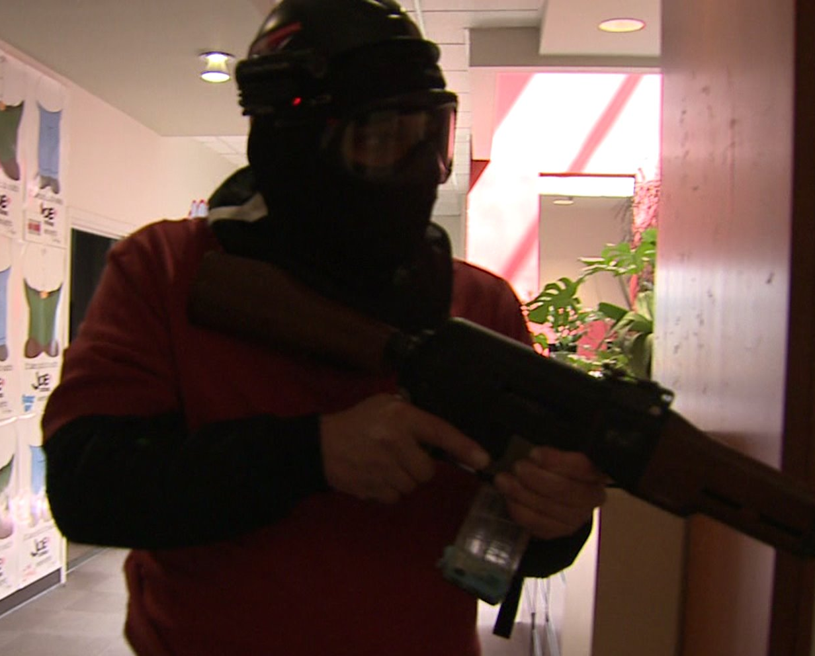
Perpetrators
Individuals, pairs or groups
Man or woman, sometimes both together
Strangers and coworkers
Managers
Employees
Majority of attackers were insiders familiar with the surroundings!!*
Each Shooter looking for an opportunity!
Notes:
“In all but two incidents, the shooter acted alone. All but six of the shooters were male. The analysis found no age pattern but noted that in the vast majority of school shootings, the shooter was a student at the school. The study did not address access to guns. Almost all of the shooters had a "real or perceived, deeply held personal grievance," said Andre Simons, unit chief for the “FBI's Behavioral Analysis Unit 2. Many of the shooters took inspiration from attacks by other shooters, such as Columbine and Virginia Tech,” Simons said. "The copycat phenomenon is real," he said.
www.usatoday.com/.../09/24/active-shooter-incidents-rising.../
*Note: If an Active Shooter is a coworker, this may compromise your plan since they’ll also know the plan. Have another location in mind where you can take your other coworkers.
Photo:catchwmw.com

Slide 11
Incident Locations
FBI determined 11 distinct location categories:
Commerce: 73 (46%)
Business Open to Pedestrian Traffic: 44 (27.5%)
Business Closed to Pedestrian Traffic: 23 (14.3%)
Malls: 6 (3.8%)
Education: 39 (24%)
Schools (Pre-K to 12): 27 (16.9%)
Institutions of Higher Education: 12 (7.5%)
Notes:
On average, Fortune 100 companies receive 12 threats a week.

Slide 12
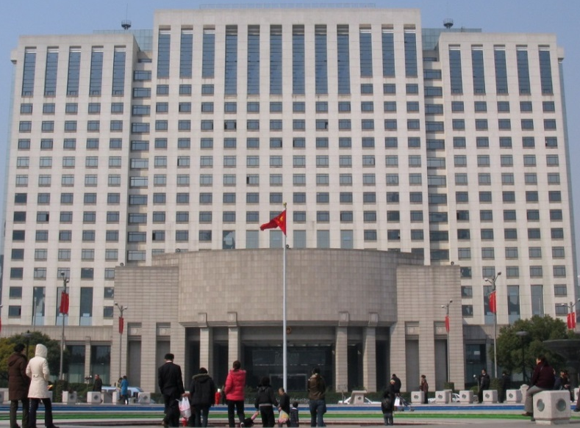
Occurrence Locations
Government: 16 (10%)
Other government property: 11 (6.9%)
Military: 5 (3.1%)
Open Space: 15 (9.4%)
Residential: 7 (4.4%)
Houses of Worship: 6 (3.8%)
Health Care: 4 (2.5%)
Notes:
“More than two thirds of the incidents analyzed by the FBI happened at businesses or schools.”
www.usatoday.com/.../09/24/active-shooter-incidents-rising.../
Photo: commons.wikimedia.org

Slide 13
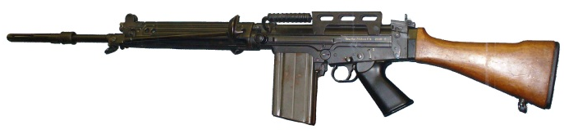
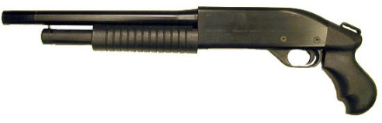
Weapons of Choice
Studying events from 2000 to 2010, weapons included:
Handgun (60%)
Rifle (27%)
Shotgun (10%)
Explosives (bomb) (3%)
In 41% of the attacks, multiple weapons were used.
Notes:
Weapons that allow a high and rapid kill number in a short span of time from a distance.
Police Chief David Magnusson from information by J. Pete Blair, Ph.D., Texas State University and M. Hunter Martaindale, Ph.D., School of Criminal Justice, Texas State University
Note that the weapons were easily concealed as well as providing high capacity.
Photos: es.wikipedia.org,
enwikipedia.org,
thespecialistsltd.com

Slide 14
Duration of Attack
49% ended before law enforcement arrived
67% ended by suicide or leaving the scene
33% potential victims stopped the shooter*
Of 64 incidents analyzed, 44 were over in 5 minutes or less. Of these 44, 23 ended in 2 minutes or less.**
Notes:
Attacks can end before law enforcement personnel arrive and many times end with the suicide or leaving of the scene by the shooter.

Slide 15
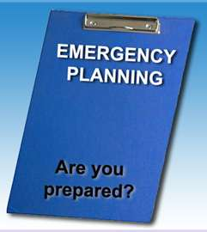
Preparedness
Perform a security survey of your facility.
Determine strong points which can be used to your advantage.
Develop an Emergency Action Plan.
Conduct training.
Recognize indicators of potential workplace violence.
Keep updated on situations which may parallel your agency (are you a target?)
Notes:
Determine Escape and Evasion methods.
Review Army Field Manual FM 3-19.30 (formerly FM19-30) “Physical Security” available from the US Army.
Know the strengths and weaknesses of your environment and how they can hinder or help you during an event.

Slide 16
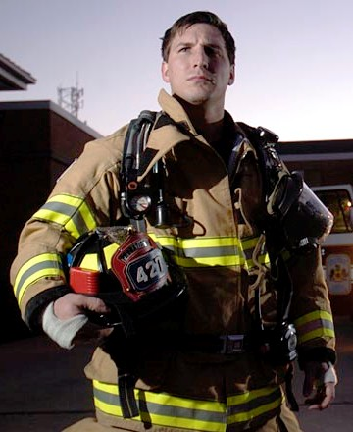
Emergency Action Plan
Get Plan input from:
Human resources department
Training department
Facility owners/operators
Property manager
Local law enforcement and emergency responders
Notes:
Take the opportunity beforehand to become familiar with your local emergency response organizations and leaders therein.
Photos:
yeswecoupon.com
candostreet.com
dlsii.com

Slide 17
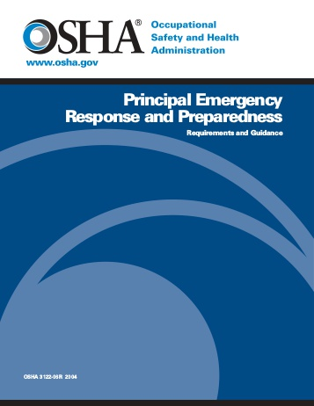
Emergency Action Plan
Include valuable information in your plan:
An emergency notification system to alert various parties of an emergency
Safe havens at your facility
Location of exits
Safe destinations once your staff has evacuated
Local area hospitals
Notes:
These rooms are similar to panic rooms or the Israeli safe rooms which can be secured against entry and protect occupants from aggressors.
Photo: yumpu.com

Slide 18
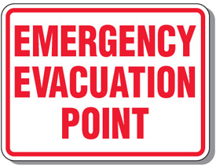
Plan Components
A preferred method for reporting different types of emergencies
An evacuation policy and procedure
Emergency escape procedures and route assignments
Contact information for individuals during an event (should remote facilities also be a target)
Notes:
Ensure you have at least the following in your plan:
A preferred method for reporting different types of emergencies
An evacuation policy and procedure
Emergency escape procedures and route assignments
Contact information for individuals during an event (should remote facilities also be a target)
Photo: emedco.com

Slide 19
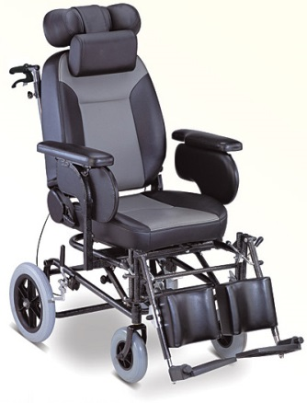
Meet Everyone’s Needs
Ensure that plans provide for functional needs of your staff:
Hearing or sight-impaired
Mobility-impaired
Limited or no English proficiency
Building should be handicap-accessible per ADA
Assign assist personnel to those who require it the same as you do for a fire evacuation.
Notes:
Make sure that your plan addresses the functional needs of your staff. Take into account any “physical challenges” employees, visitors and others may have.
Photo: medimoon.com,
mobilityaids.in,

Slide 20
Preparedness/Prevention
Locate and post 2 evacuation routes
Involve local Law Enforcement and First Responders in your training
Have Emergency Response training at your facility
Review past events at other locations to determine problems and benefits found during their event to include in your plan
Have a respectful workplace
Be alert to workplace violence indicators and respond to them
Notes:
Being prepared and preventing active shooter incidents is the best chance employees have to survive these types of incidents.

Slide 21
HR Responsibilities
Human Resources should:
Conduct effective background checks.
Create system for reporting violent behavior.
Make counseling available.
Develop plan dealing with an active shooter situation.
Notes:
Determine potential problems before the individual is introduced/permitted into the facility
This is not just supervisor training but general employee training on recognizing and reporting this behavior.
Provide requisite counseling for staff going through difficult times. Some may need only to resolve issues impacting them to once again be a valued employee.
Get input from all your personnel.
Photo: forbes.com

Slide 22
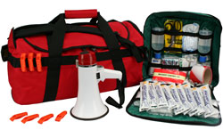
Manager Responsibilities
Institute access controls.
Assemble crisis kits.
- Radios - Floor plans
- Rosters - 1st Aid Kits - Flashlights
3. Distribute kits and other critical items.
Floor plans
Keys
Personnel lists/phone numbers
Notes:
Consider creating safety zones within larger safety areas and protecting entry through key card access
Distribution of critical items may be done before an event. Just as each floor or area has a First Aid kit, so also should each have a ready kit to respond to an Active Shooter event.
Photo: evaq8.co.uk

Slide 23
Manager Responsibilities
Activate the emergency notification system.
Ensure two evacuation routes.
Coordinate with the facility’s security department.
Post evacuation routes.
Place removable floor plans near entrances and exits.
Include law enforcement and first responders in training.
Encourage active shooter training.
Foster a respectful workplace.
Be aware of workplace violence indicators.
Notes:
In addition to those already mentioned, managers have other important responsibilities.

Slide 24
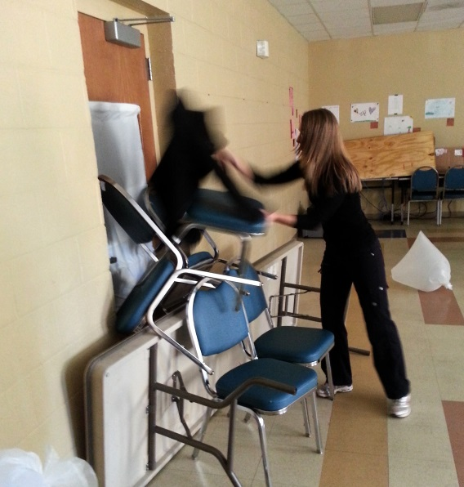
Manager’s Response
Manager’s Reactions
Take immediate action
Stay calm
Lock & barricade doors
Evacuate all personnel via pre-planned route to a safe area.
Notes:
When responding to an active shooter situation managers must react properly.
Photos: sparqvault.com,
wfae.org

Slide 25
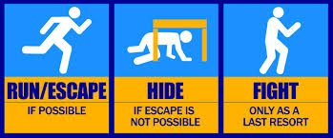
Your Response
Run
Hide
Fight
Your Mission: Stay Alive!
Notes:
The recommended response to an active shooter is to Run, Hide and Fight.
Run – Escape if possible; get as far away from the situation as safely possible.
Hide – If escape is not possible, find a place to hide that is out of the shooter’s view; stay hidden until law enforcement arrives and the area is
determined by them to be safe.
Fight – Use only as a last resort. Find something to strike the shooter with if possible.
Photo: qcc.edu

Slide 26
Run
Have an escape route and plan in mind.
Leave your belongings behind.
Help others escape, if possible.
Evacuate regardless of others.
Warn and prevent individuals from entering.
Notes:
Put distance between you and the threat. Also put walls (obstructions) between you and the threat.
During your planning, view floor plans which permits tracing evacuation routes with walls and barriers between your start point and exit.
Photo: videonemo.com

Slide 27
Provide Information
If safe to do so, provide 911 operators and Law Enforcement (LEN) Officers with:
Location of shooter
Number of shooters
Physical description of shooters
Number and types of weapons
Number of potential victims
Follow dispatcher’s or police instructions
Notes:
If on a phone or if law enforcement has arrived and if you have met them on the scene, they’ll need vital information you can provide.
Photo: freetext.com

Slide 28
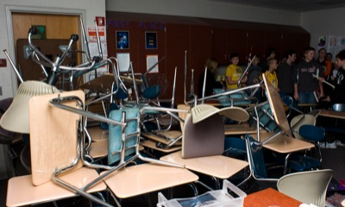
Hide
Your hiding spot should:
Be out of the active shooter’s view.
Be protective if shots are fired.
Select a “hardened” area during planning
Should not restrict options for movement.
Notes:
Allows you time to think and determine your response.
A “hardened” area would one with substantial walls; cinderblock or metal, which would serve to shield you from gun fire.
“If you look at all the shootings, in all the years, in all the locations, they’ve never taken time to kick down or shoot through a locked door.” Dr. John Nicoletti, expert in workplace and school violence based in Lakewood, Colorado (www.emergencymgmt.com/safety/FBI-Active-Shooting-Incidents-Triple.html)
Photo: danilo-amelotti.com,
dailystandard.com

Slide 29
Keep Yourself Safe
If the shooter is nearby:
Lock & barricade the door to your safe area.
Hide behind large item (e.g., cabinet, desk).
Silence your cell phone/pager.
Remain quiet.
Stay in-place until law enforcement arrives at your location.
Notes:
Keeping safe is the number one priority in surviving an active shooter event.
Photo: emergency.arlingtonva.us

Slide 30
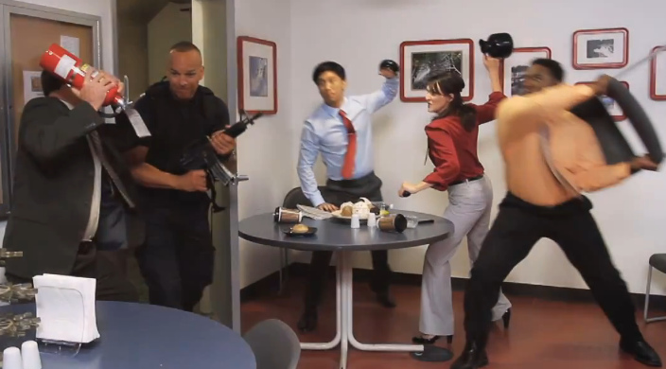
Fight
This is an absolute last resort:
Act as aggressively as possible.
Improvise weapons and throw items.
Yell.
Commit to your actions.
Whether you’re alone or with a group-
you fight to live!
Notes:
As a last resort, whether you’re alone or with a group-you fight to live! Remember, your life and the lives of others depend upon it. Don’t be uneasy with “fighting dirty,” use whatever tactics you can to survive!
Photo: emergency.arlingtonva.us

Slide 31
Fight
Possible Defensive Weapons
Some of these will require you to “close the distance” between you and the attacker-Very Dangerous!
Letter Opener or scissors
Pepper Spray
Rat tail comb
Sharpened pencil
Fire Extinguisher: release the agent into the shooter’s face, then close-in.
Notes:
Remember, some of these weapons would require you to “close the distance” between you and your attacker. This can be very dangerous!
Photos: glamourbeautycenter.com,
buybizsupplies.com,
supplygeeks.com

Slide 32
Law Enforcement Arrival
Law Enforcement’s Immediate purpose:
Stop the active shooter
Proceed to area where last shots were heard
First priority is to eliminate the threat
Secondary teams will provide EMS support
Notes:
The entry team will be 4 in number specially trained to get to the source of the problem.
Photo: policecrunch.com

Slide 33
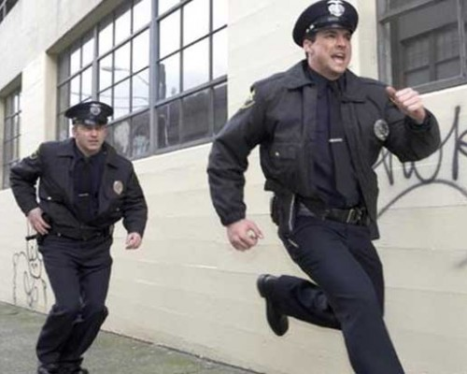
Additional Teams
Officers and Rescue Teams may:
Wear bulletproof vests, helmets, and other equipment
Wear a variety of uniforms or be in civilian clothes
Be armed with rifles, shotguns, and/or handguns
Use pepper spray
Shout commands
Push individuals to the ground for their safety
Notes:
Follow the directions of law enforcement!!
Photo: thelibertarianrepublic.com

Slide 34
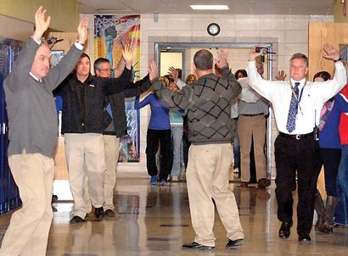
Reacting to Law Enforcement
Remain calm.
Put down any items.
Raise empty hands and spread fingers.
Avoid quick movements.
Avoid pointing, screaming or yelling.
Listen to LEN Officers and heed their directions
Proceed in direction from which officers are entering unless directed otherwise.
Notes:
It should be understood that police need to identify the shooter.
Photo: ironmountaindailynews.com

Slide 35
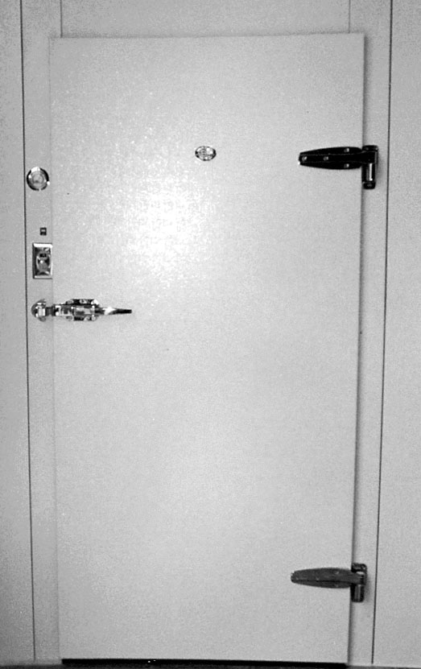
Safe Location
You will be moved to a safe location:
An area controlled by law enforcement until the situation is under control.
All witnesses are identified and questioned.
Notes:
This means separating potential victims from the shooter. This can only be accomplished in a chaotic situation by individually identifying and clearing each person.
Photo: eastmanbusinesspark.com,
pix-hd.com

Slide 36
Managing Consequences
Determine who is missing or injured (accountability location)
Determine a method for notifying families.
Assess psychological state of individuals and provide for stress counseling.
Identify and fill critical personnel or operational gaps.
Notes:
Accountability is achieved by rosters determining employees and visitors.
Where victims exist, families must be notified (best left to the authorities).
Critical Incident Stress Debriefing (CISD) may be required-this was a traumatic event!
Assign critical persons to perform required duties.
Photo: accidental.com.au

Slide 37
Post-Event Actions
Important to:
Manage consequences
Critique lessons learned
Results:
Promotes well-being of those involved
Facilitates preparedness for future emergencies
Notes:
Photo: npt-business.co.uk

Slide 38
Post-Event Actions
Document response activities.
Review and Critique your response to the incident
Identify successes and failures.
Analyze and improve the EAP
Improve safe areas of facility
List post-event actions you should take that day and in the coming weeks.
Notes:
Review of a distant, similar event which provides insight to your future actions.
Learn from the event. A look at past terrorist events shows they may “revisit” the same locations.
Photo: greatleadershipbydan.com

Slide 39
Conduct Training
Train Staff on Workplace Violence Indicators
Display characteristics of potentially violent behavior.
Increased alcohol/drug use
Paranoid, Depressed or Withdrawn
Violates company policies
Unstable or explosive temper
Suicidal intentions voiced
Holds a grudge against coworkers or the company
Talks about getting even with coworkers
Notes:
“Active Shooter, How to Respond,” U.S. Department of Homeland Security, 2008.

Slide 40
Conduct Training
Employee training should also include:
Identifying the sound of gunfire
Reacting quickly
Running (Evacuating)
Hiding
Fighting
Notes:
Appropriate training should be provided to all employees.
Photo: drnnarang.com

Slide 41
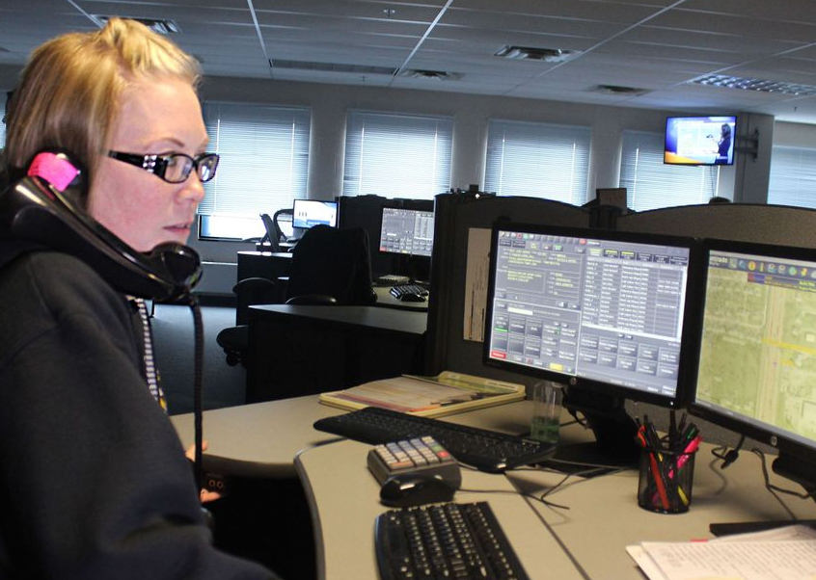
Conduct Training
Calling 911.
Adopting a survival mindset during the crisis.
Reacting when law enforcement arrives.
Notes:
Employees who are properly trained have a higher chance of surviving an active shooter event.
Photo: whio.com

Slide 42
Safety Policies
Dismissing an employee:
Have a team meet with the employee to be dismissed
Have Security or Police escort from premises
Inform other employees of the dismissal
Provide Security for a period of time at the facility after the dismissal action
Notes:
Not knowing how the employee will act being told they are being dismissed (fired), do not allow a single person to be tasked with this action.
Having Security or Police involved in escorting the employee from the facility adds protection to your people.
By informing others of the dismissal action, they will know something may be amiss should they see the dismissed employee on the premises in following days.
Safety and Security to the facility and staff during a “cool-down” period, promotes overall safety.
Inform staff of actions to be taken should they report to work and find the dismissed individual on the grounds, i.e. in a parked car in the parking lot. Maybe you would not want your people to be exposed. Have an accountability destination communicated after the event.
Photos: brighamgroup.com,
eascomp.blogspot.com

Slide 43
Summary
If confronted with an Active Shooter situation, run, hide then fight
If safe to do so from your safe location, call 911 and provide vital information
Be aware of the two nearest exits and evacuate if safe to do so
Know your environment and possible dangers all the time
Remember your mission is to survive!!
Notes:
Remember, the number priority is survival!

Slide 44
Contact Information
Health & Safety Training Specialists
1171 South Cameron Street, Room 324
Harrisburg, PA 17104-2501
(717) 772-1635
RA-LI-BWC-PATHS@pa.gov
Like us on Facebook! - https://www.facebook.com/BWCPATHS
PPT-061-02
44
Notes:
We invite you to contact us for other free power point programs which you can use for your in-house programs. Also, please feel invited to contact us to conduct training for your staff at your location. Other downloadable programs can be found at www.dli.state.pa.us/PATHS under training resources.

Slide 45
Questions

Slide 46
Bibliography
FEMA, IS-907-Active Shooter: What You Can Do. A course developed by the National Protection and Programs Directorate/Office of Infrastructure Protection, U.S. Department of Homeland Security. IP_Education@HQ.dhs.gov
Active Shooter Incidents:
www.usatoday.com/.../09/24/active-shooter-incidents-rising.../16158921

Slide 47
Bibliography
FBI Law Enforcement Bulletin:
http://leb.fbi.gov/2014/january/active-shooter-events-from-2000-to-2012
FBI: Active Shooting Incidents Triple in Recent Years: http://www.emergencymgmt.com/safety/FBI-Active-Shooting-Incidents-Triple.html
Campus Safety Magazine: http://www.campussafetymagazine.com/article/FBI-Report-Frequency-of-Active-Shooter/Events-Has-Increased#

Slide 48
Bibliography
Police Chief David Magnusson: https://linkedin.com/pulse/active-shottin-statistics-something-ponder-david-magnusson
Regroup, “Active Shooter Events on Track to Rise Again in 2014,” http://www.regroup.com/welcome/active-shooter-events-on-track-to-rise-again-in-2014
“Active Shooter, How to Respond,” U.S. Department of Homeland Security, 2008

Slide 49
Bibliography
“Active Shooter Study: Quick Reference Guide,” Federal Bureau of Investigation, 2014
“5 Phases of the Active Shooter Incident,”
https://www.policeone.com/active-shooter/articles

Slide 50
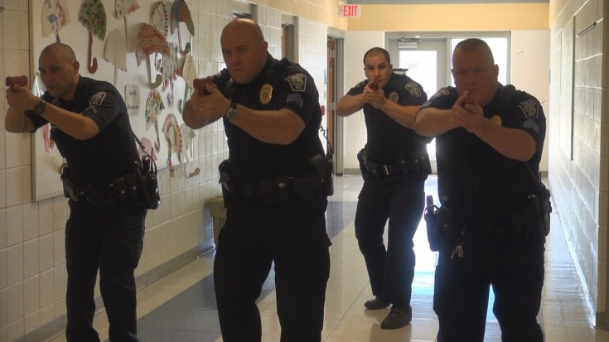
Related Programs
The following programs available from us may aid you in providing more in-depth training to the previous topic.
Dealing with Angry People
Emergency Action Plans
Emergency Response Planning
Managing Emergencies
If not found on our website: www.dli.state.pa.us/PATHS email us for a copy.

