Slide 1
Preparing Students for the 21st Century Workforce Guiding team-based project work using a project management framework
Presented by
Mr. Brian Petrus, PHR
Dr. Helen Boylan
Dr. Alison DuBois
August 4, 2020
Westminster
College

Slide 2
Agenda
Introduction: Project Management Overview
EPMA: Team-Based Project Work in Action
PM Software: Choices & Applications
Workshop Breakout: Backyard Garden Project
Group Discussion: Challenges & Benefits
Closing Thoughts: SCRUM & Virtual Classes
Q & A: Please feel free to speak with us after the workshop if you have additional questions, thoughts, or comments

Slide 3
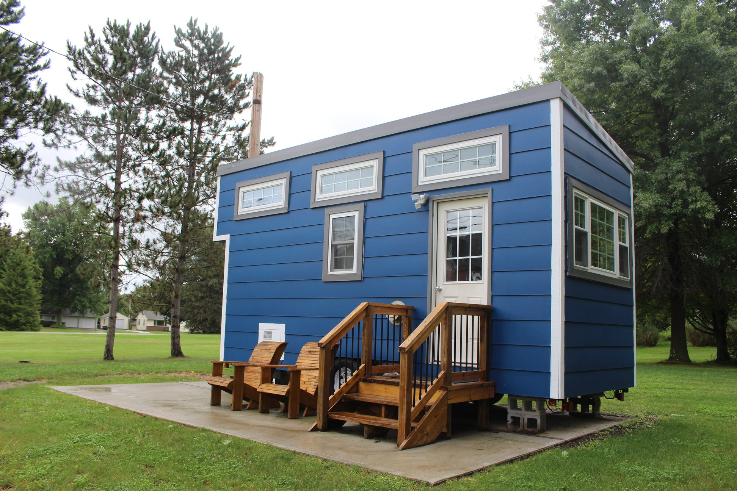
Project Management Overview
Project management is the application of processes, methods, skills, knowledge and experience to achieve specific project objectives according to the project acceptance criteria within agreed parameters. Project management has final deliverables that are constrained to a finite timescale and budget.
(2008). A guide to the project management body of knowledge (PMBOK® Guide). 4th ed. Newtown Square, Pa.: Project Management Institute, Inc.

Slide 4
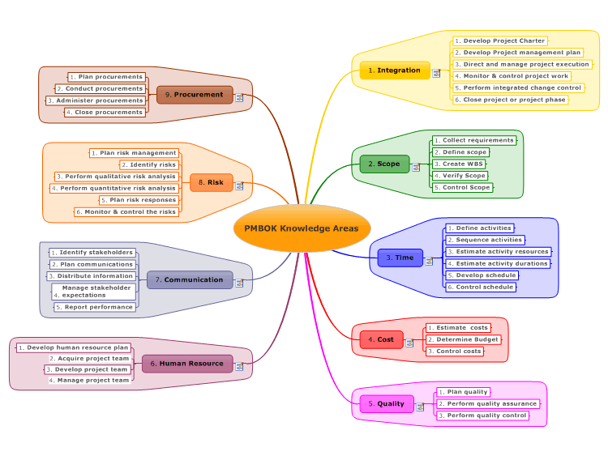
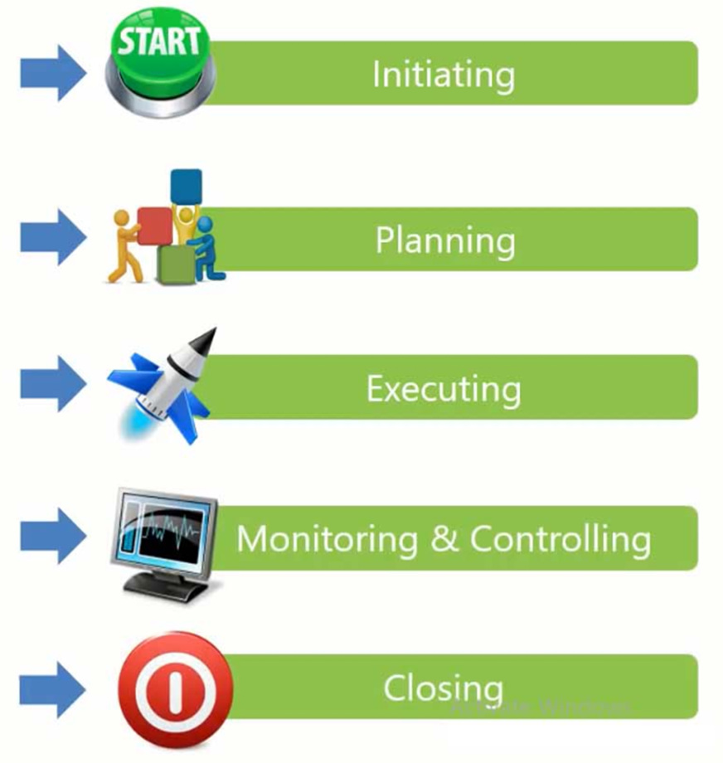
Project Management Overview

Slide 5
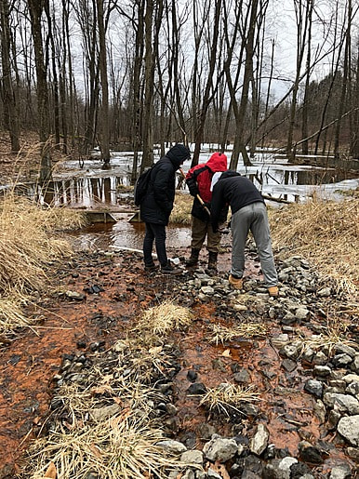
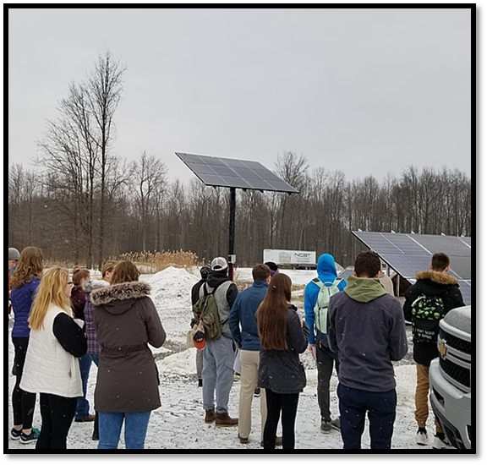
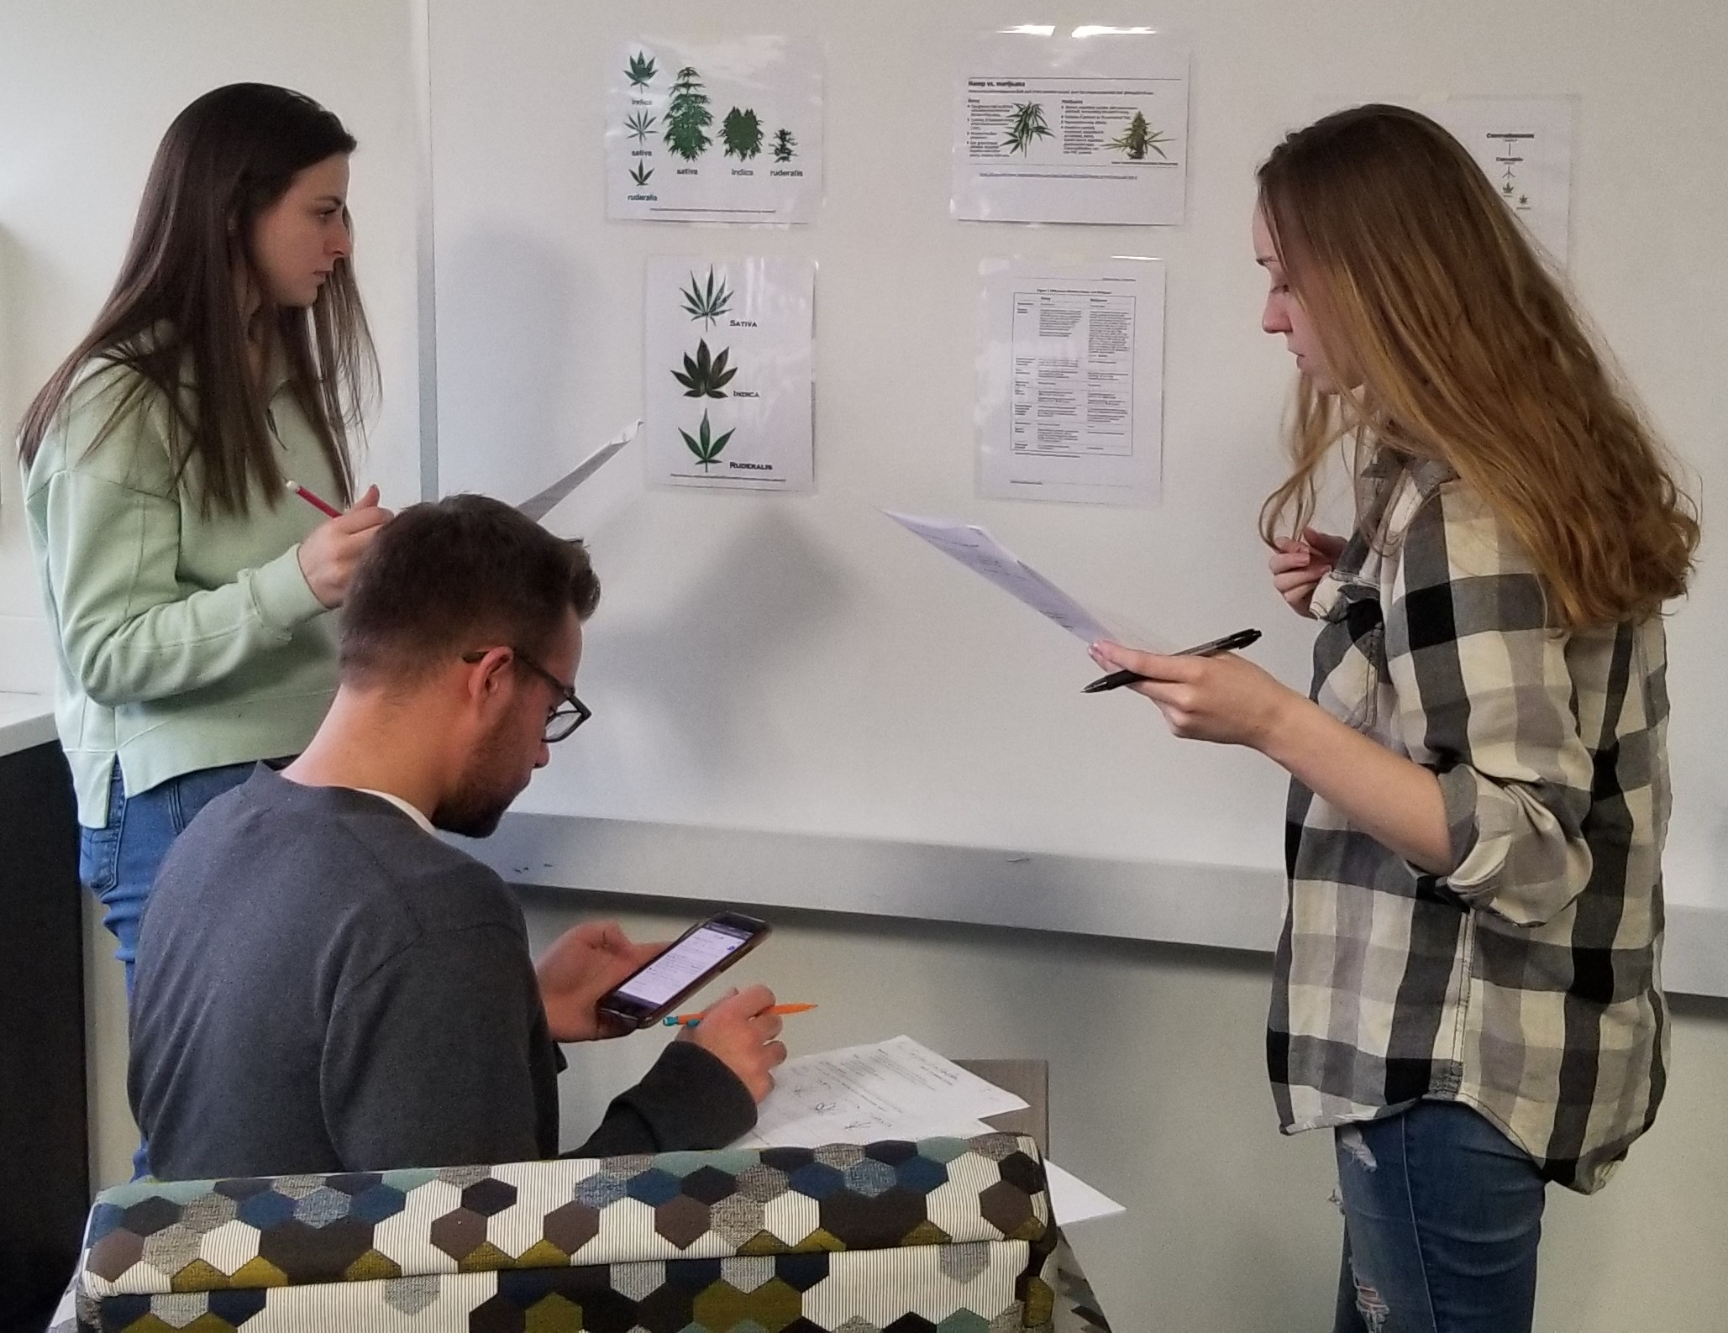
EPMA: Team-Based Project Work
Year 2: Feasibility Study on Mineral Recovery from AMD
Year 3: Informational Website on
Industrial Hemp
Year 1: Feasibility Study on Solar Energy
Community Partner:
DON Services, Inc.
Community Partner:
New Wilmington Borough
Community Partner:
Slippery Rock Watershed Coalition (SRWC)

Slide 6
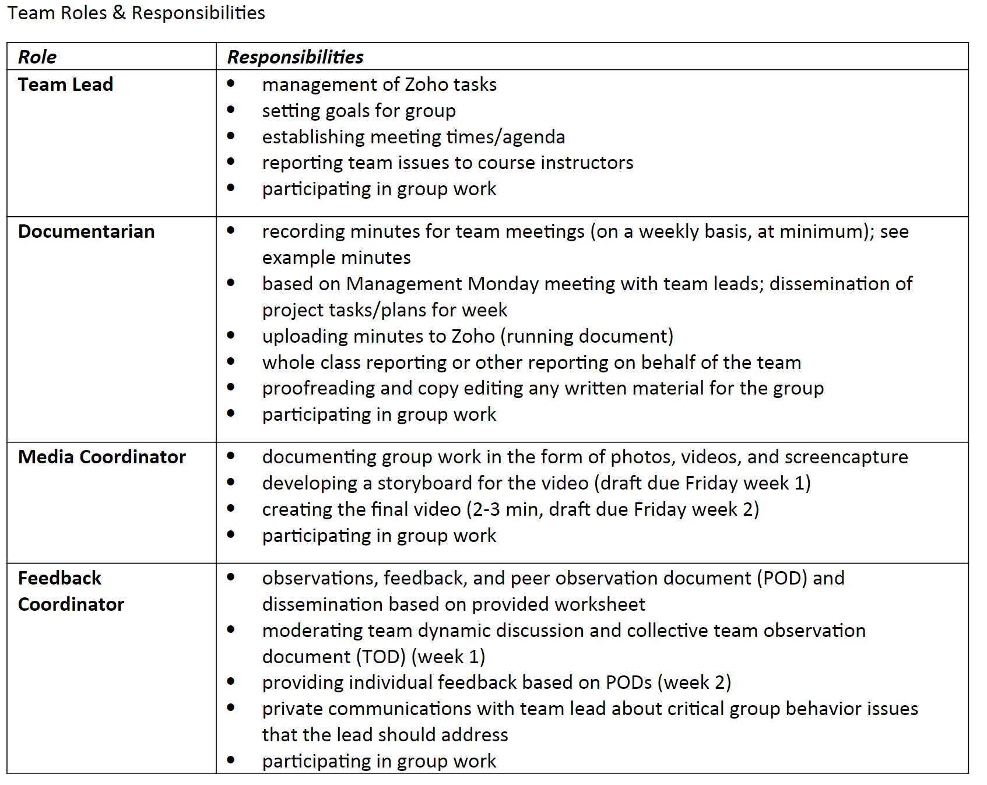
EPMA: Team-Based Project Work Challenges
Building the Team & Designating Roles
KSACs
Skills Development Desires
Work/Life Balances (RAM – Resource Assignment Matrix)

Slide 7
Project Management Software Applications
Ease of Use
Functionality
Time Tracking
Reporting Tools

Slide 8
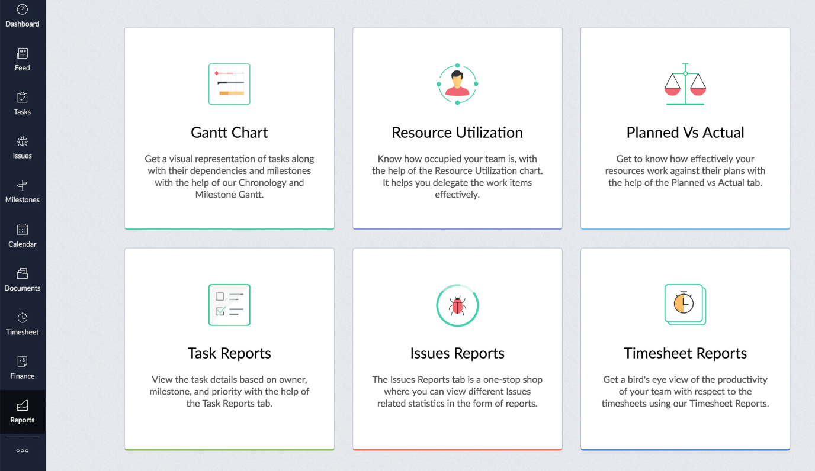
ZOHO Basics

Slide 9
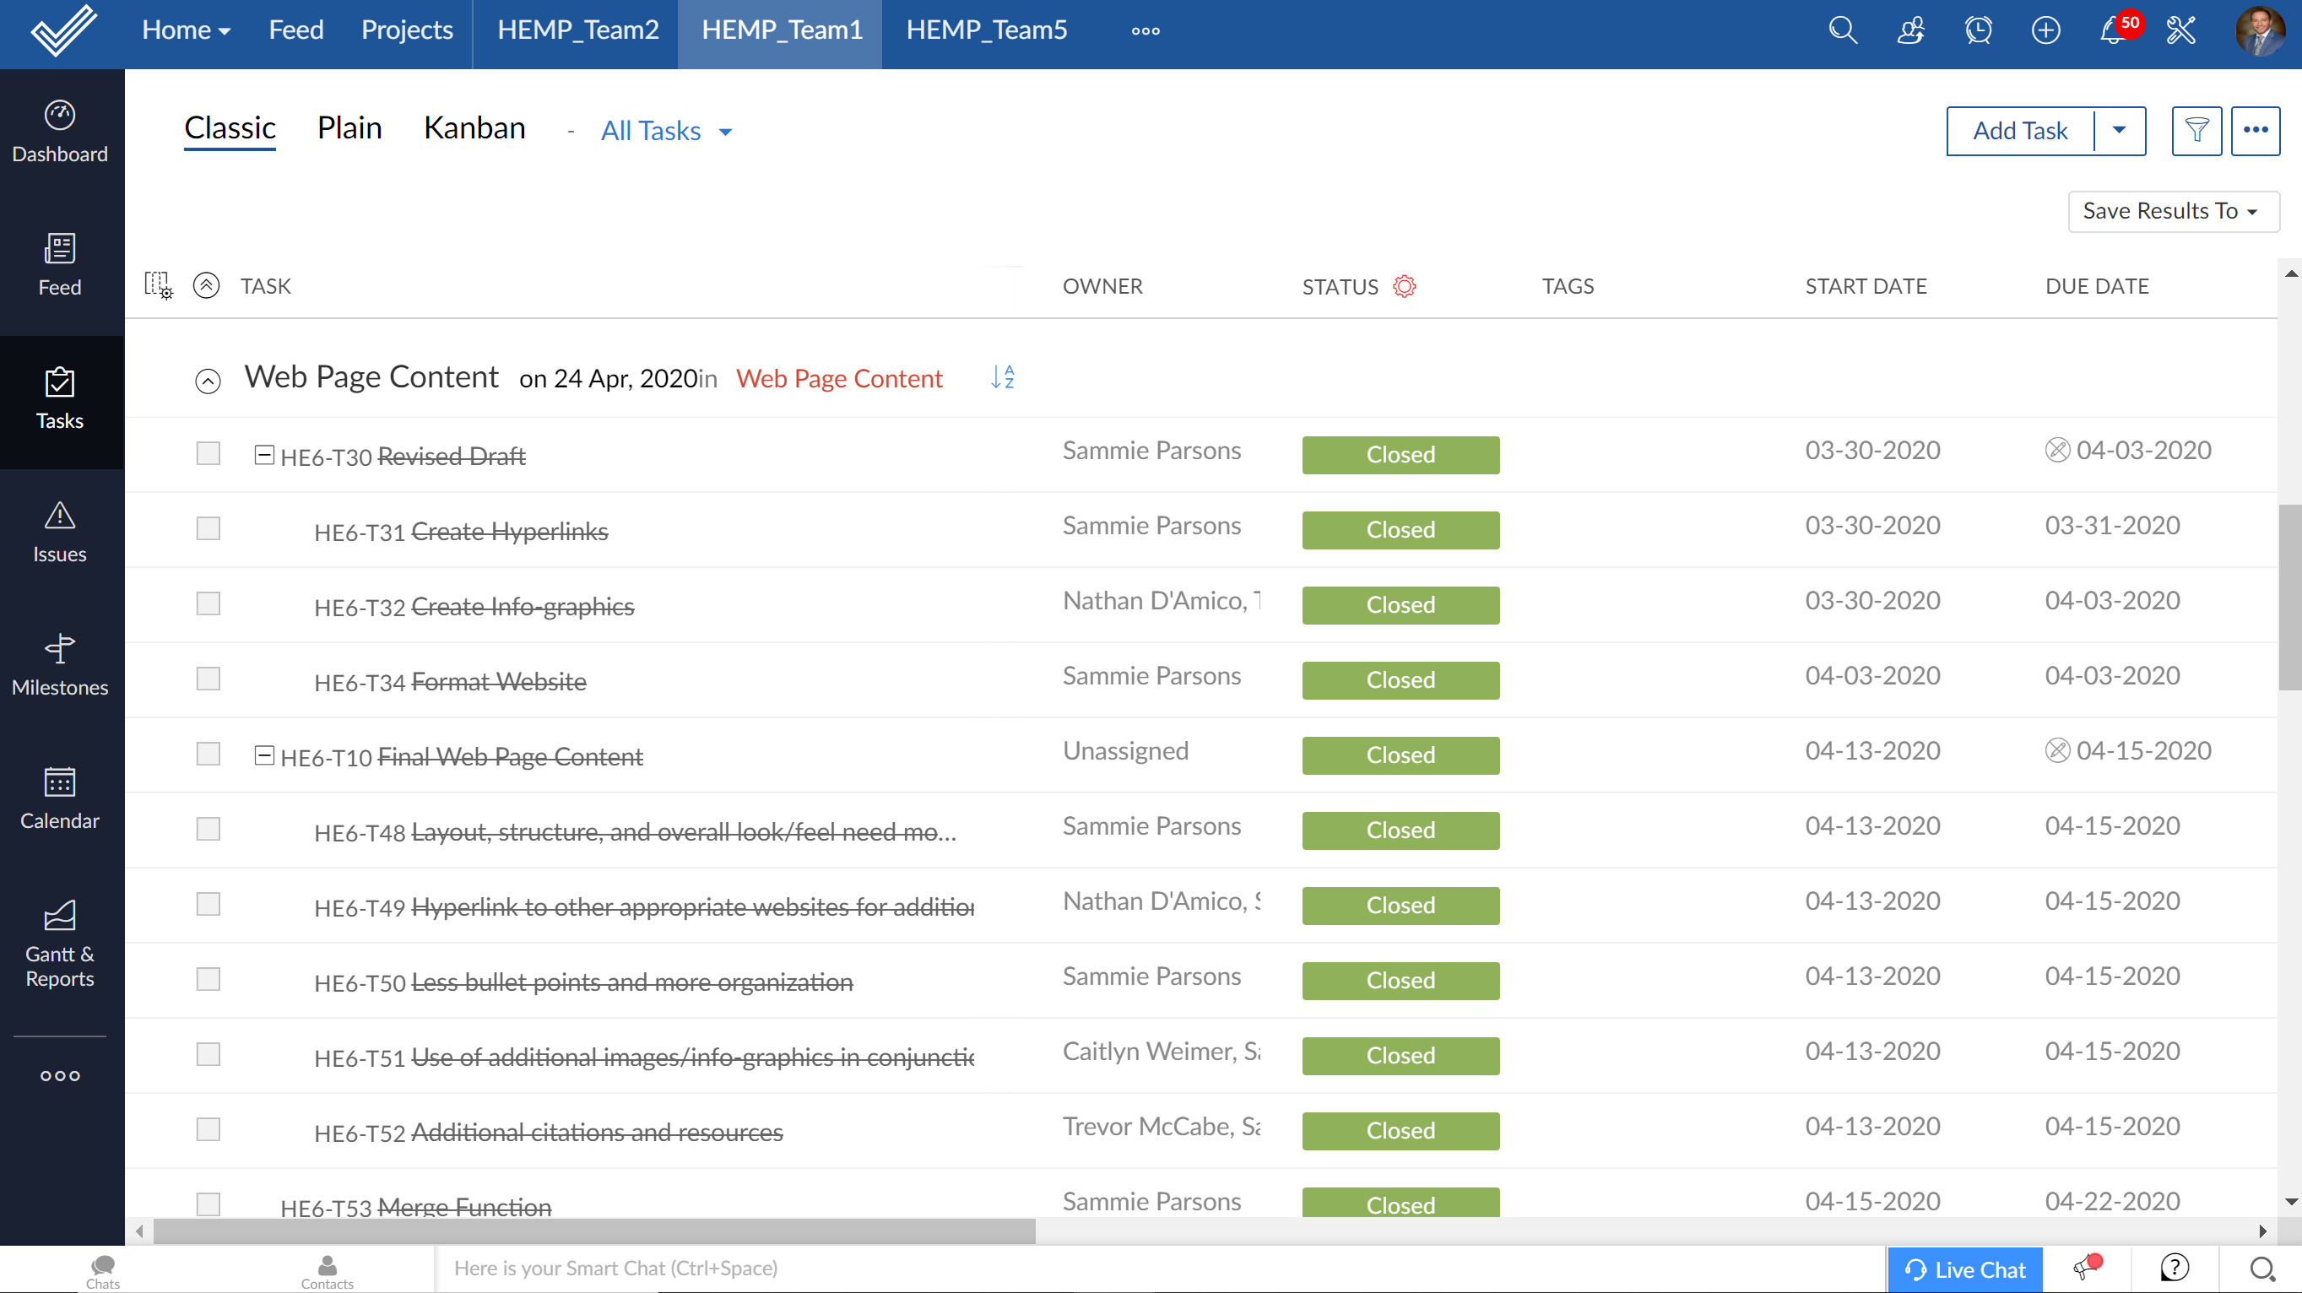
PM in Action

Slide 10
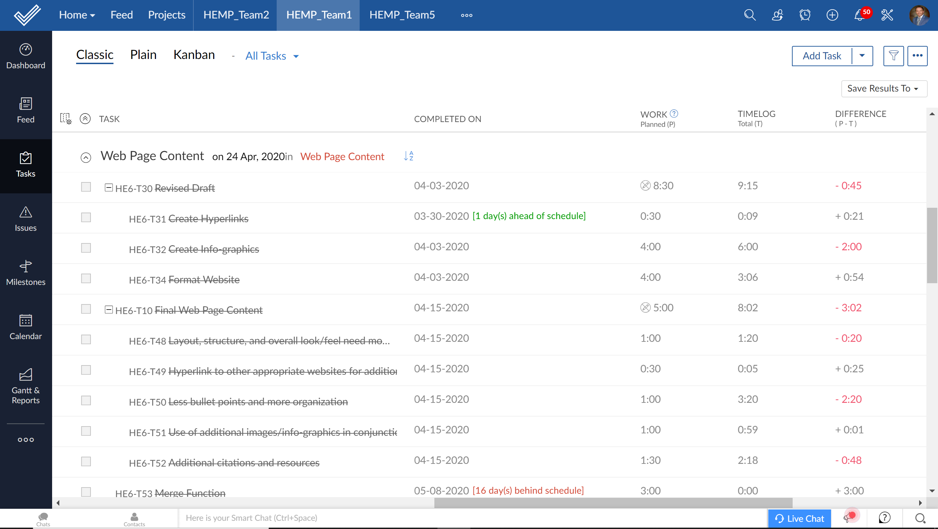
PM in Action

Slide 11
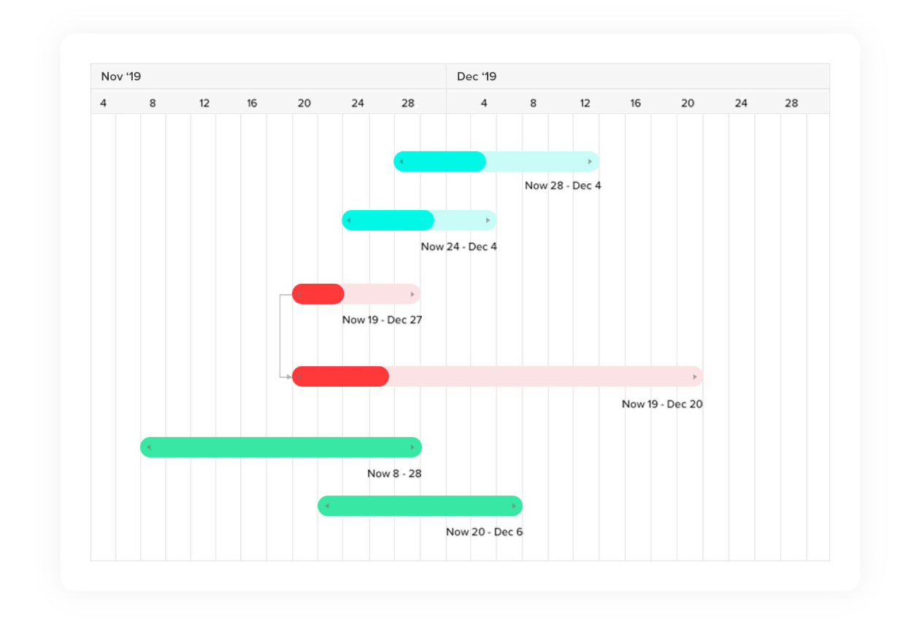
Today’s PM Framework Goal
Get the big picture with Gantt charts
Use Gantt charts to build a project plan and track the task schedule.
Keep track of critical tasks and their dependencies, and immediately pinpoint any deviations between planned and actual progress.
Assists with evaluating who is contributing and where.
Visualize, Monitor, and Control

Slide 12
Scope, Milestone, and Task Approach
Scope refers to the detailed set of deliverables or features of a project.
Importance of scope management and avoiding scope creep
A milestone is a control station in a project; significant event in a project that occurs at a specific point in time.
Consideration of milestone “sprints” or short jumps between deliverables
A task is an activity that needs to be accomplished within a defined period of time or by a deadline to work towards an associated milestone.
Creating task lists
Avoid creating a “laundry list” of tasks

Slide 13
Project Management: Breakout Activity
Backyard Garden Project (15 minutes)
Groups of 5 will be randomly assigned
Activity Steps:
The group decides on who will play the role of the Team Lead (only person to build the Gantt Chart)
The group brainstorms backyard garden ideas (deck pots, raised garden, in-ground garden, greenhouse, etc.)
The group develops a brief (SMART – Specific, Measurable, Attainable, Relevant, and Time-Bound) Scope statement
The group develops a Milestone stone list with appropriate dates
The group develops a Task list with appropriate dates
View your timeline and consider how cost, time, quality, teamwork, and risks can impact your project success.
After the 15 minutes has expired, we’ll reconvene and discuss as a group.

Slide 14
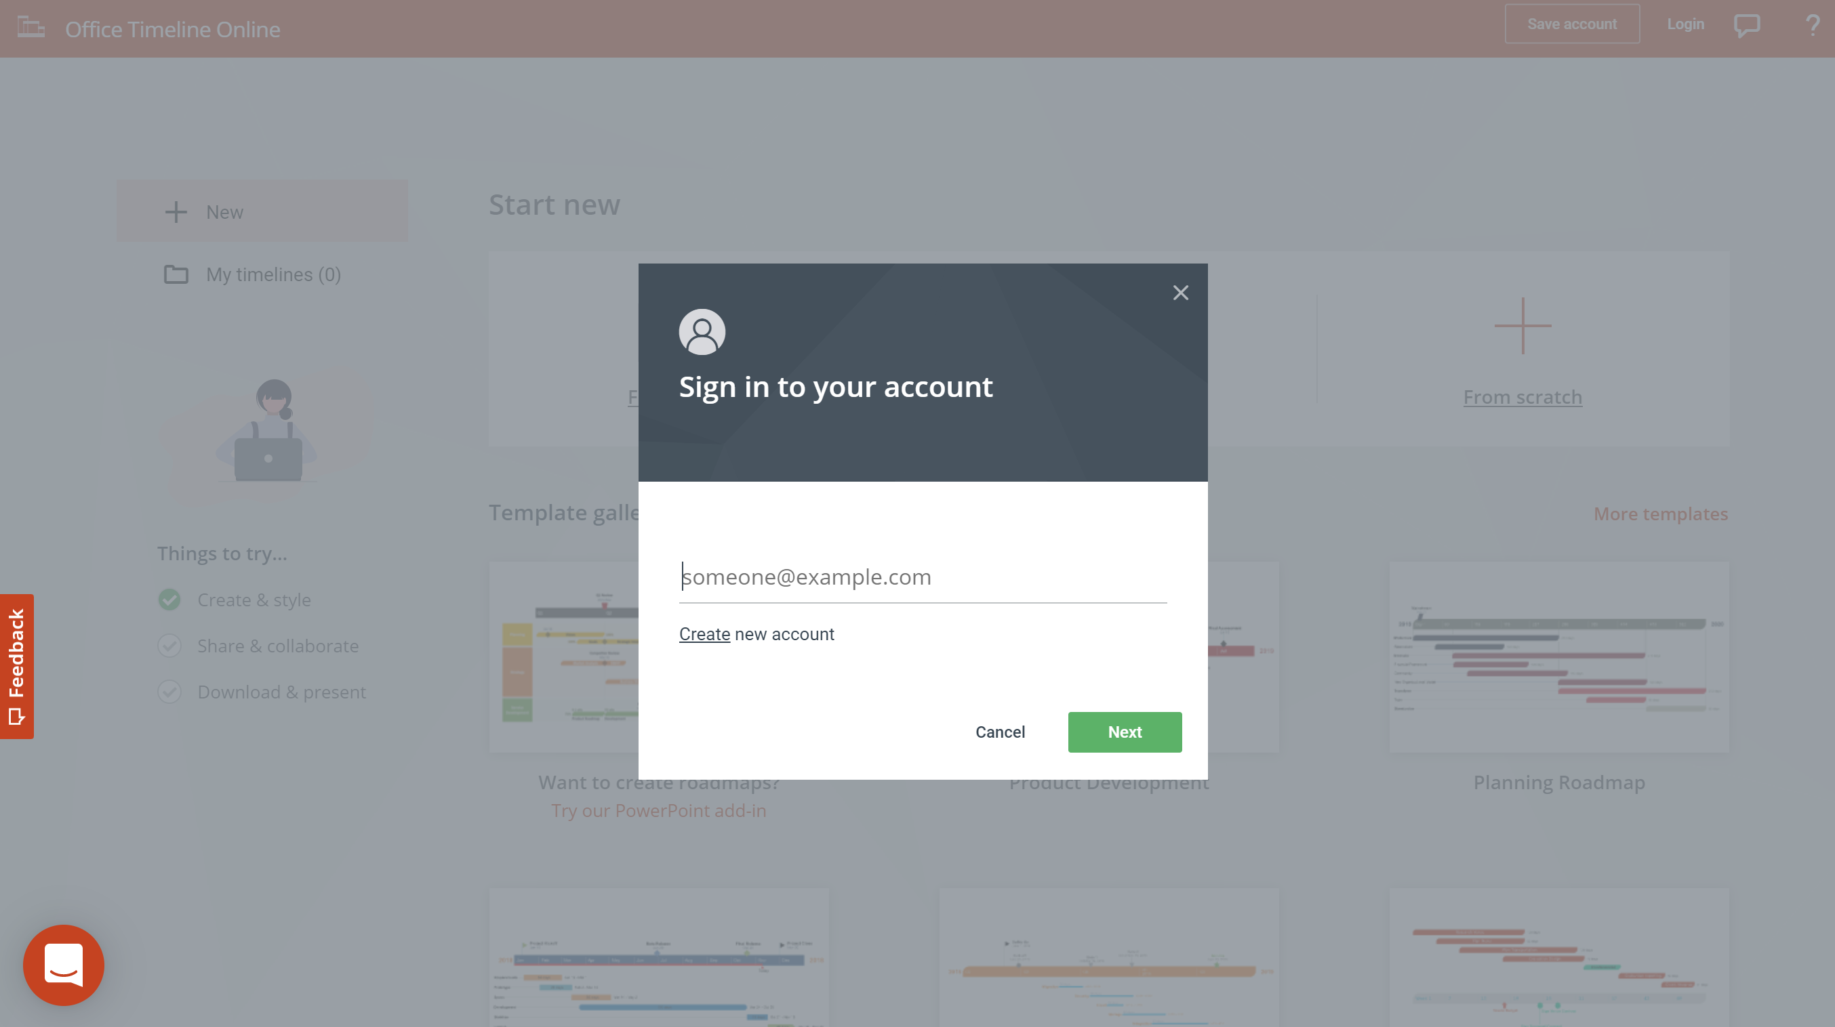
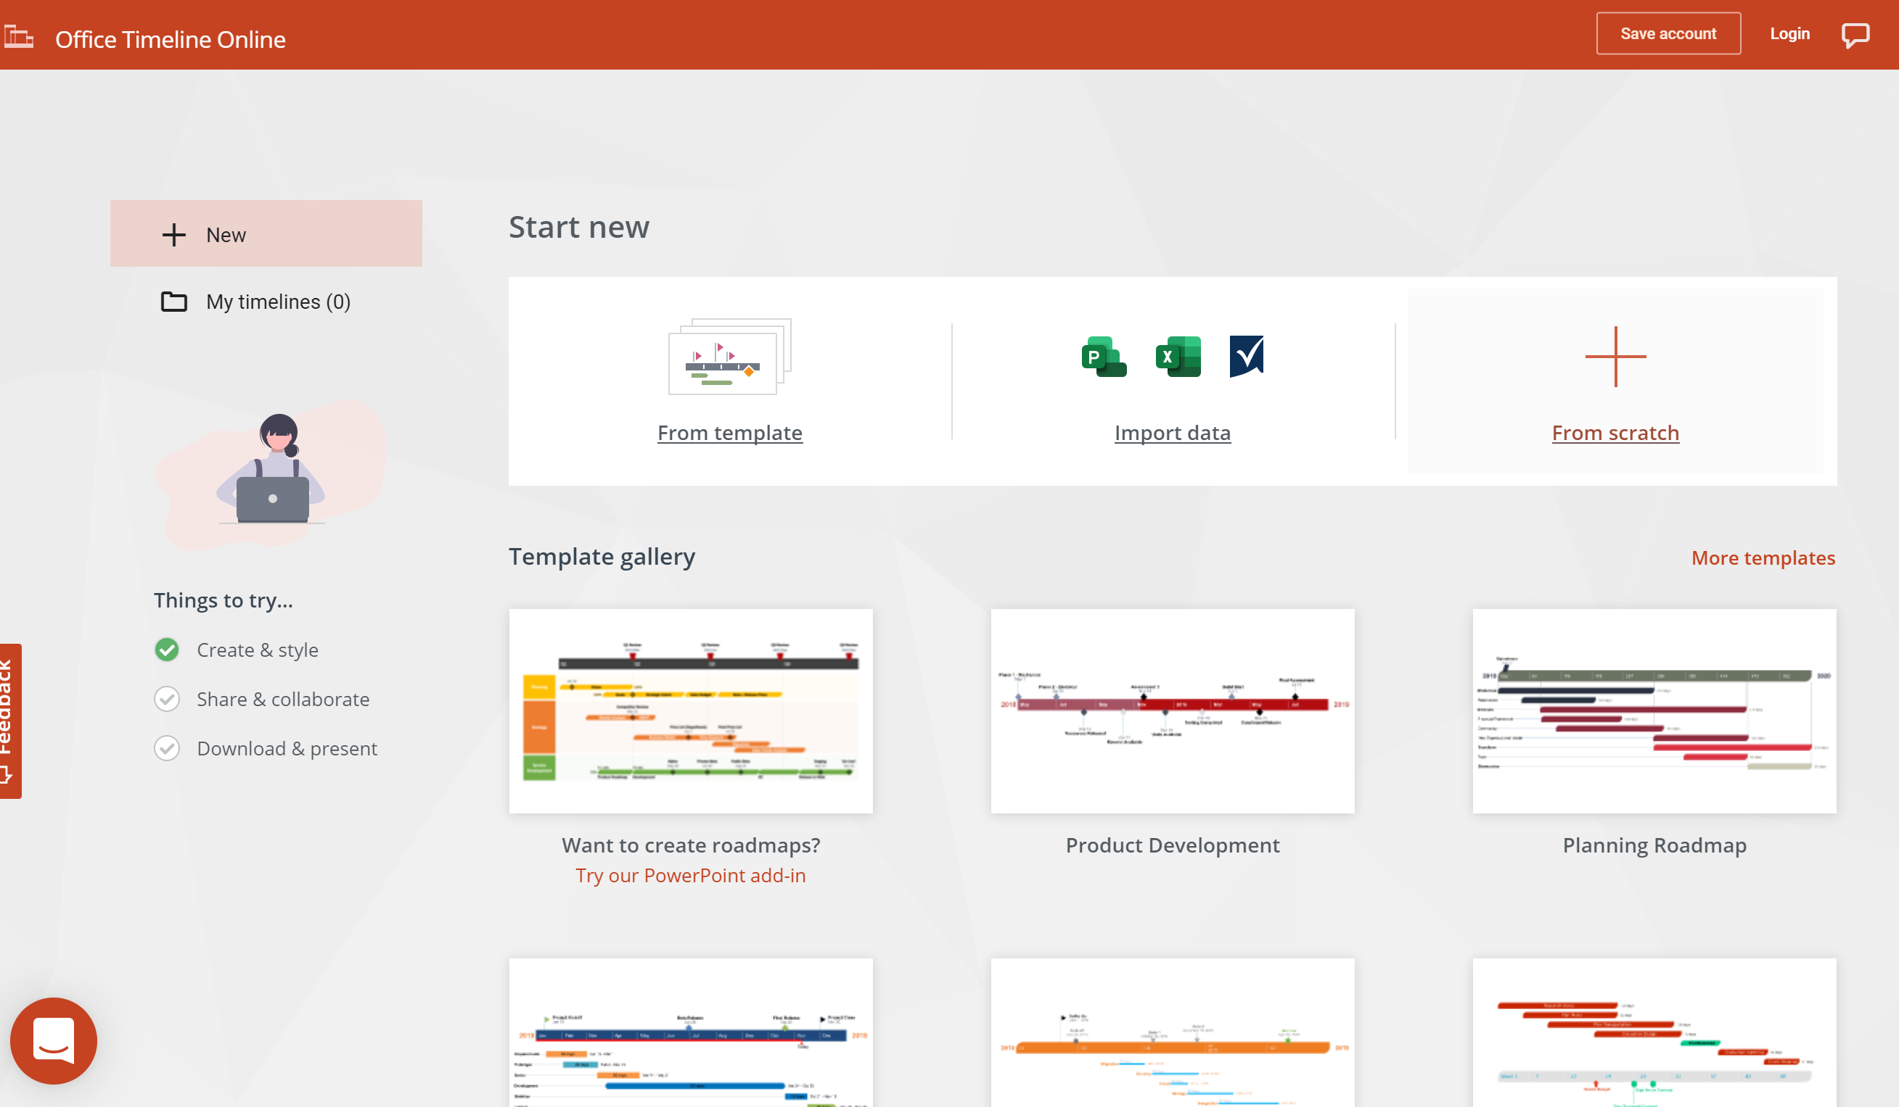
Project Management: Breakout Activity
https://online.officetimeline.com/app/#/new-from-template
No need to sign in (cancel out)
Under the Start New banner, select “From Scratch”

Slide 15
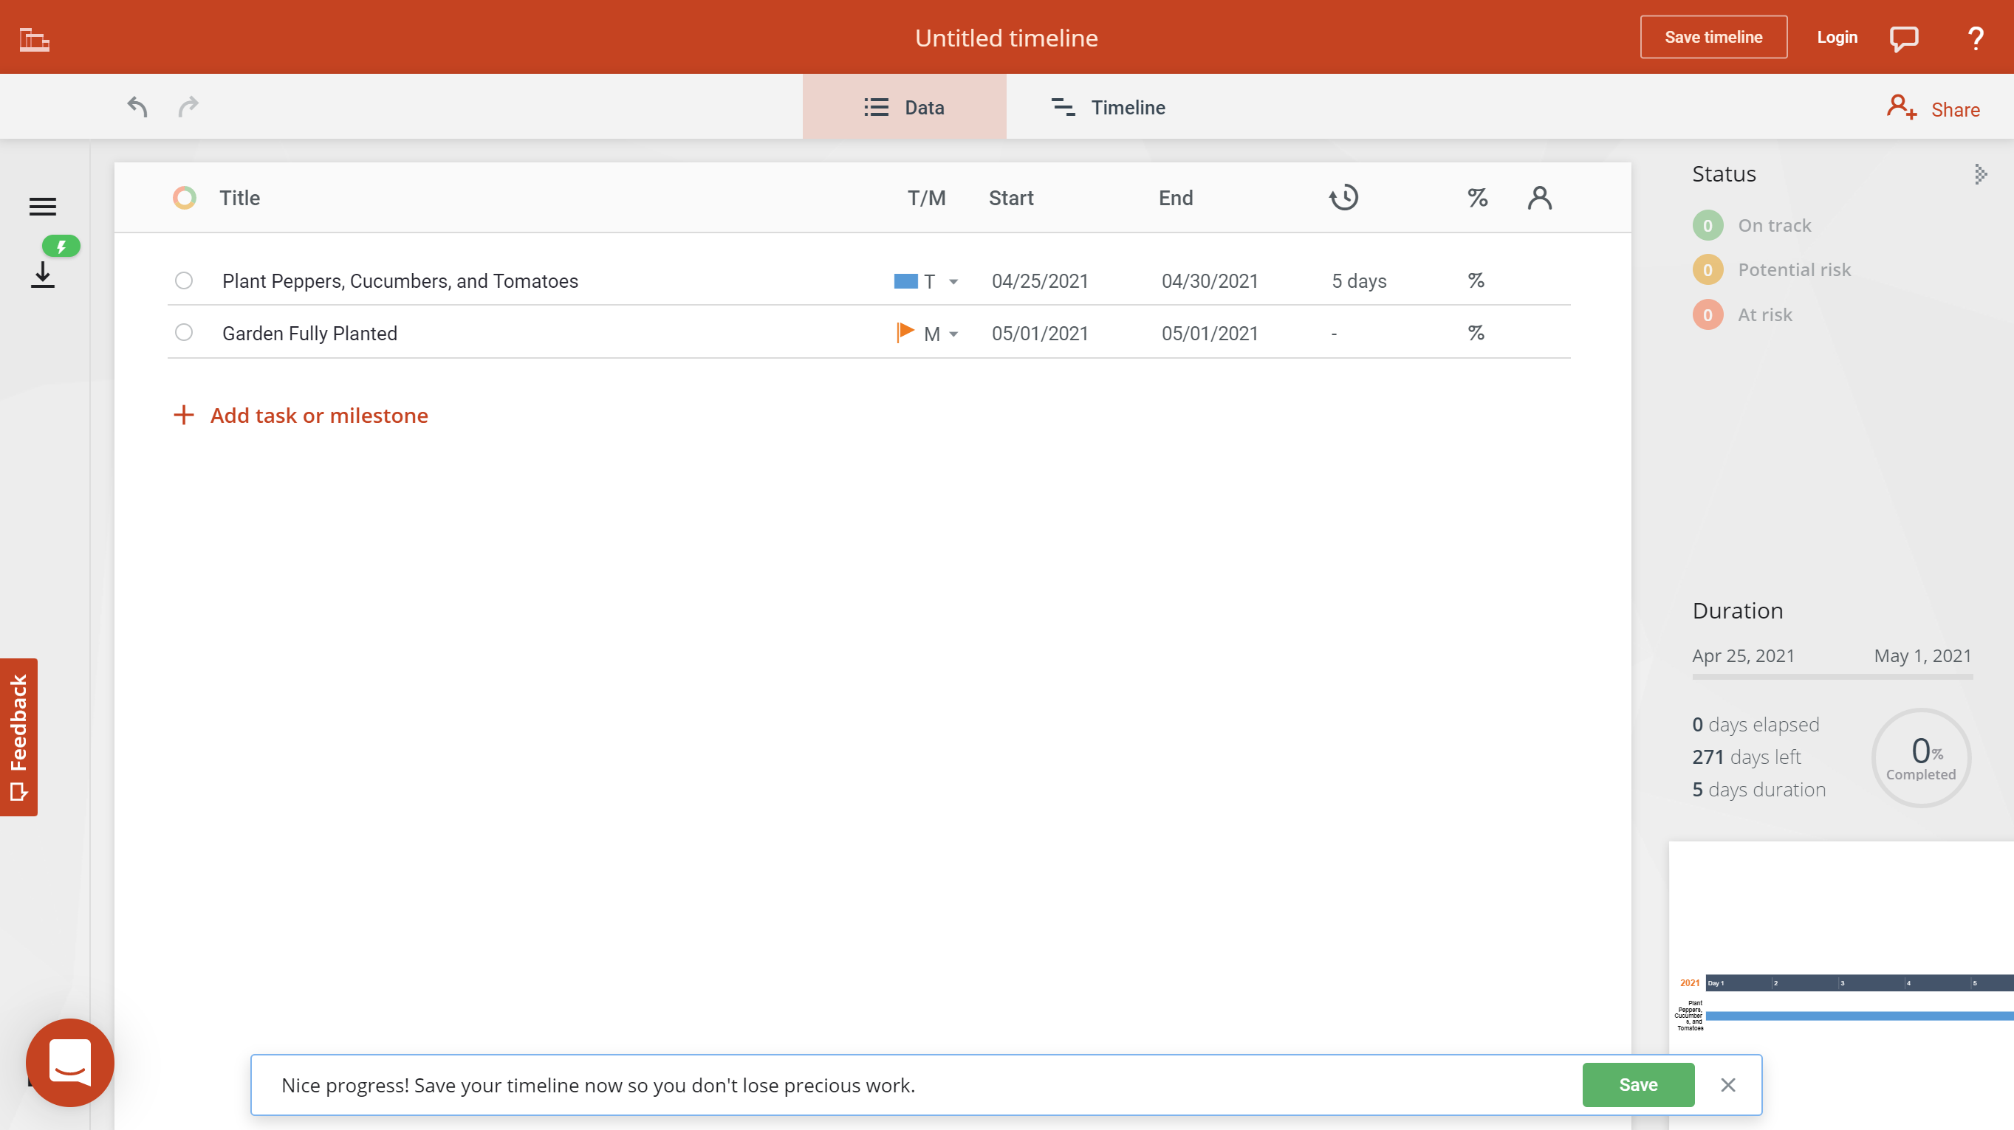
Project Management: Breakout Activity

Slide 16
Project Management: Breakout Activity

Slide 17
Project Management: Breakout Activity
Group Discussion

Slide 18
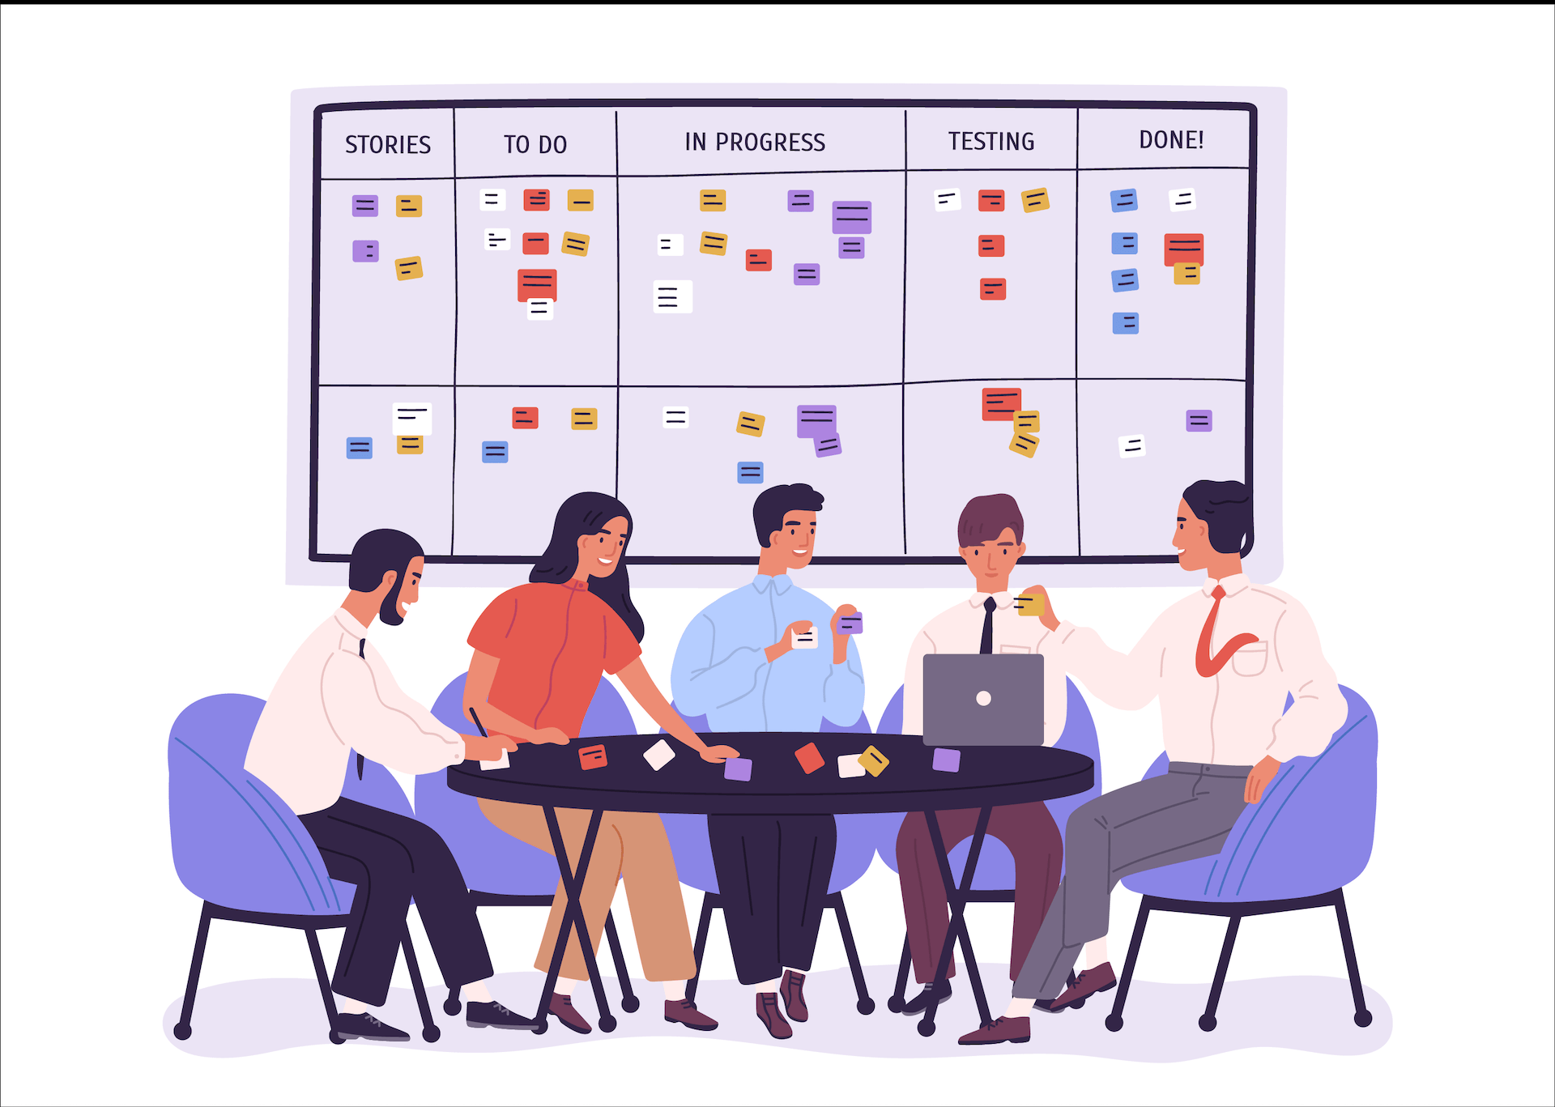
PM Considerations
3 General Project Management Considerations:
Everything is always more complicated than predicted
Everything always takes longer than anticipated
Everything always costs more than projected
Management Strategies BEYOND the software:
Management Mondays – Project Updates with Team Leads
Workshop Wednesdays – Guided Project Work
Feedback Fridays – Feedback Loops & Performance Improvement Plans

Slide 19
Project Management: SCRUM Framework
Daily & Weekly SCRUM Board
Make a list of your current projects based on priority (backlog)
Break the high priority items into manageable weekly goals (bites)
Further break down what you can accomplish in a given day
Extrapolate the bites further
Move the sticky notes across your folder as your progress in the daily/weekly SCRUM process
Stay up-to-date on your project & manage your priorities in a more agile manner

Slide 20
Virtual Teaching with PM Frameworks: Challenges, Benefits, and Innovation
Resistance to technology: Establish the framework and expectations from day one
Expectations: SMART Goals – Specific, Measurable, Attainable, Relevant, Time-Bound
Daily/Weekly SCRUM process: Mimic a workplace environment and enhance student knowledge, skill, ability, and other competencies
Cross-functional team work and interdisciplinary learning
Effective communication, both written and oral

Slide 21
Acknowledgments & Thanks
The National Science Foundation: TUES Award Number 1712028
Collaborators:
Year 1: The New Wilmington Borough
Year 2: The Slippery Rock Watershed Coalition
Year 3: DON Services, Inc.
External Evaluators: Student Cohorts: Special Thanks:
Mr. Michael Gross 22 WC Students in Year 1 All of you here today!
Mr. Jeremy Lynch 21 WC Students in Year 2
Mrs. Ann Puskaric 20 WC Students in Year 3
Mr. Randy Cain
Mrs. Sandra Webster

Slide 22
Q&A

